Slide 1

Lecture Eleven
Entity-Relationship Modelling
Based on Chapter Eleven of this book:
Database Systems: A Practical Approach to Design, Implementation and Management
International Computer Science S.
Carolyn Begg, Thomas Connolly

Slide 2
Lecture 11 - Objectives
How to use Entity–Relationship (ER) modeling in database design.
Basic concepts associated with ER model.
Diagrammatic technique for displaying ER model using Unified Modeling Language (UML).
How to identify and resolve problems with ER models called connection traps.
How to build an ER model from a requirements specification.

Slide 3
Database
Definition
  A database is an organized collection of data that allows for efficient storage, retrieval, and management of information. It is designed to store data in a proper structure and enables users to create, read, modify, and delete data from this structure.
  Database is a shared collection of logically inter-related data

Slide 4
Definition of Database Management System (DBMS)
A Database Management System (DBMS) is software that allows users to create and manage a database, and store, update, delete, and retrieve data efficiently from that batabase
It serves as an interface between the database and users (applications)

Slide 5
Entity Relationship (ER) Modeling
Definition:
ER Modeling is a conceptual database design technique used to define the structure of a database.
It visually represents entities, attributes, and relationships before implementation.
Why is ER Modeling Important?
Helps in designing a structured database schema.
Reduces redundancy and improves efficiency.
Provides clarity before implementing the database in SQL.

Slide 6
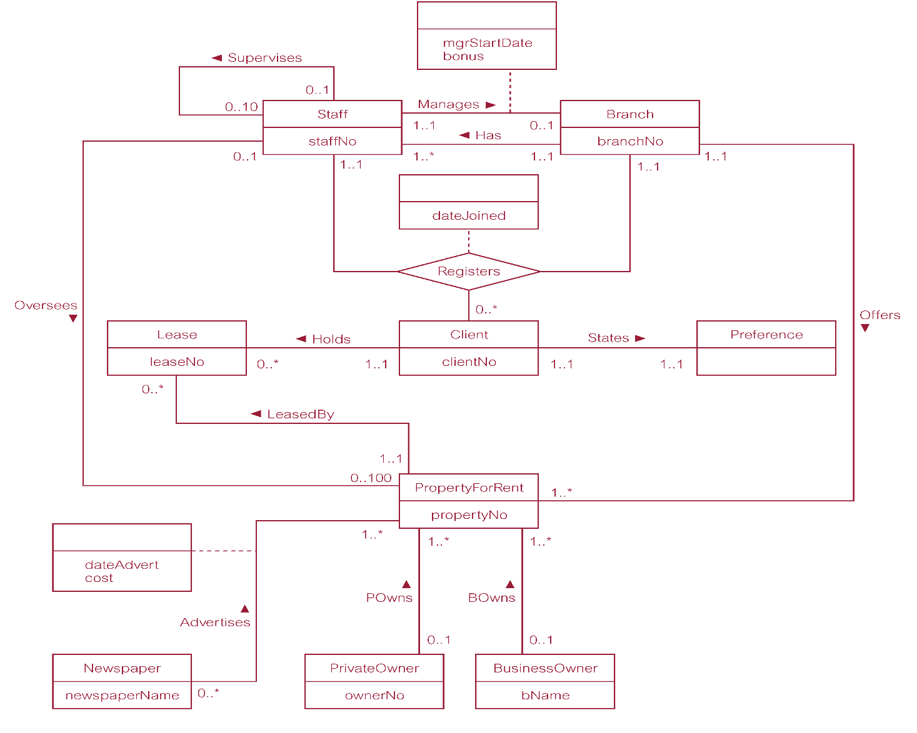
ER diagram of Branch view of DreamHome

Slide 7
Concepts of the ER Model
Entity types
Relationship types
Attributes

Slide 8
Entity Type
Entity type:
  Group of objects with same properties, identified by enterprise as having an independent existence.
Entity occurrence:
  Uniquely identifiable object of an entity type.

Slide 9
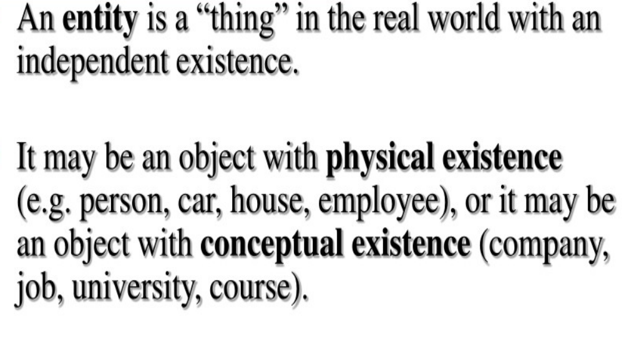
Entity Type

Slide 10
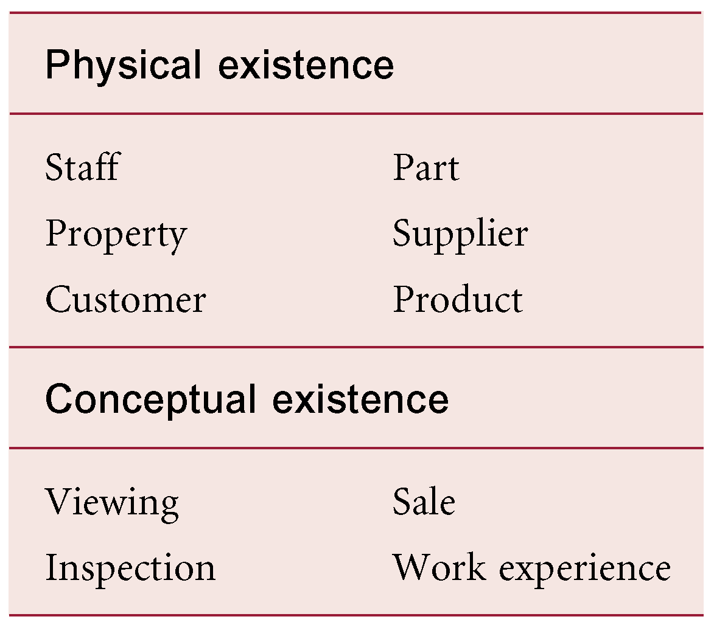
Examples of Entity Types

Slide 11
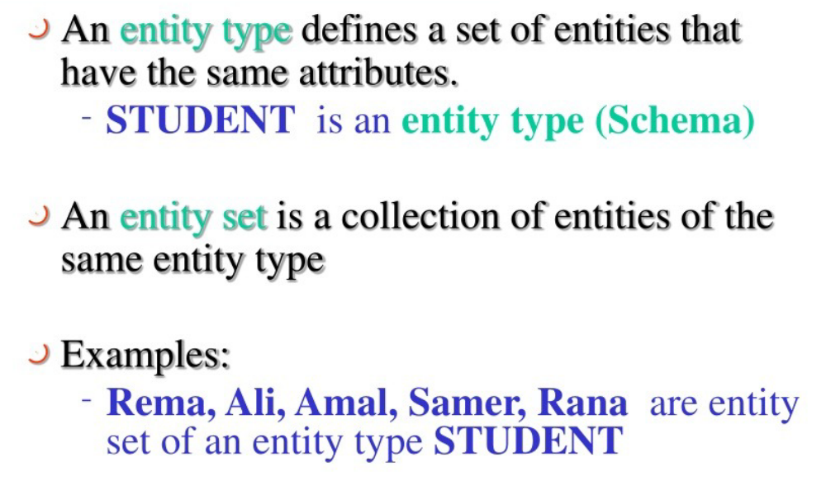
Entity Type and Entity Set

Slide 12
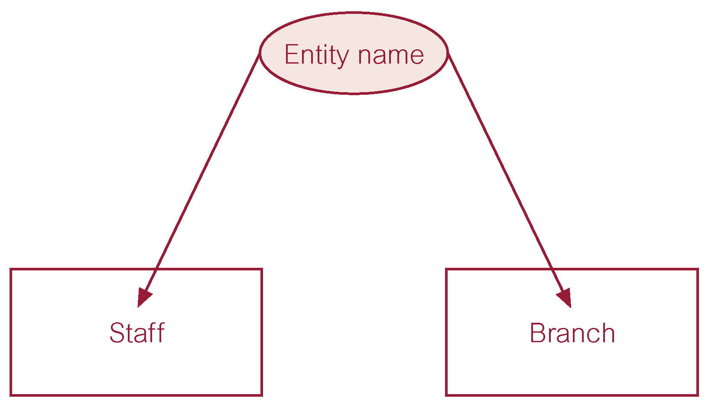
ER diagram of Staff and Branch entity types

Slide 13
Attributes
Attribute:
  Property of an entity or a relationship type.
Attribute Domain:
  Set of allowable values for one or more attributes.

Slide 14
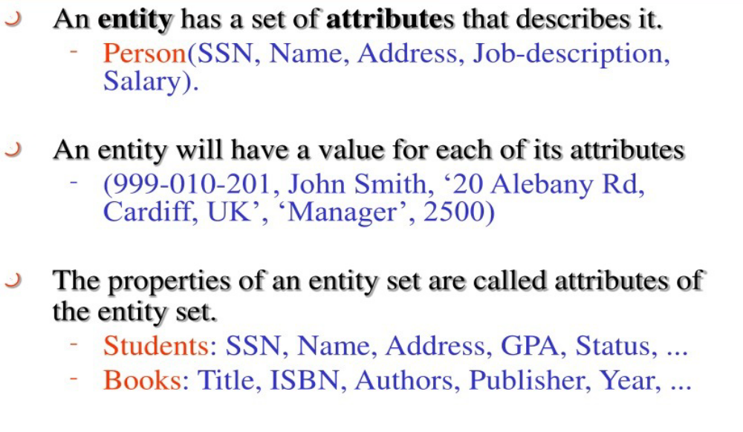
Attributes

Slide 15
Attributes
Simple Attribute:
  Attribute composed of a single component with an independent existence.
Composite Attribute:
  Attribute composed of multiple components, each with an independent existence.

Slide 16
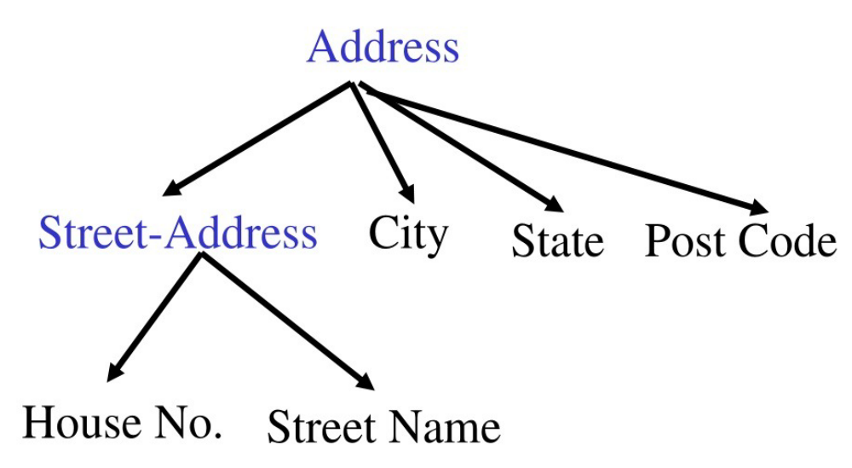
Example of Composit Attribute

Slide 17
Attributes
Single-valued Attribute:
  Attribute that holds a single value for each occurrence of an entity type.
Multi-valued Attribute:
  Attribute that holds multiple values for each occurrence of an entity type.

Slide 18
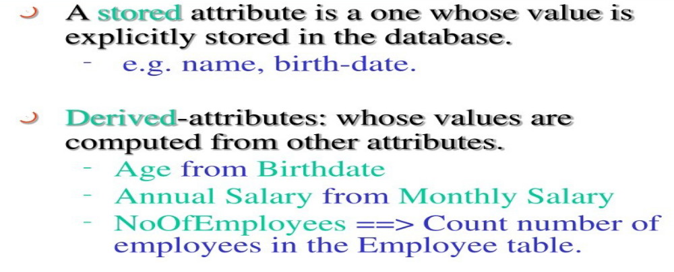
Attributes
Derived Attribute:
  Attribute that represents a value that is derivable from value of a related attribute, or set of attributes, not necessarily in the same entity type.

Slide 19
Relationship Types
Relationship type:
  Set of meaningful associations among entity types.
Relationship occurrence:
  Uniquely identifiable association, which includes one occurrence from each participating entity type.

Slide 20
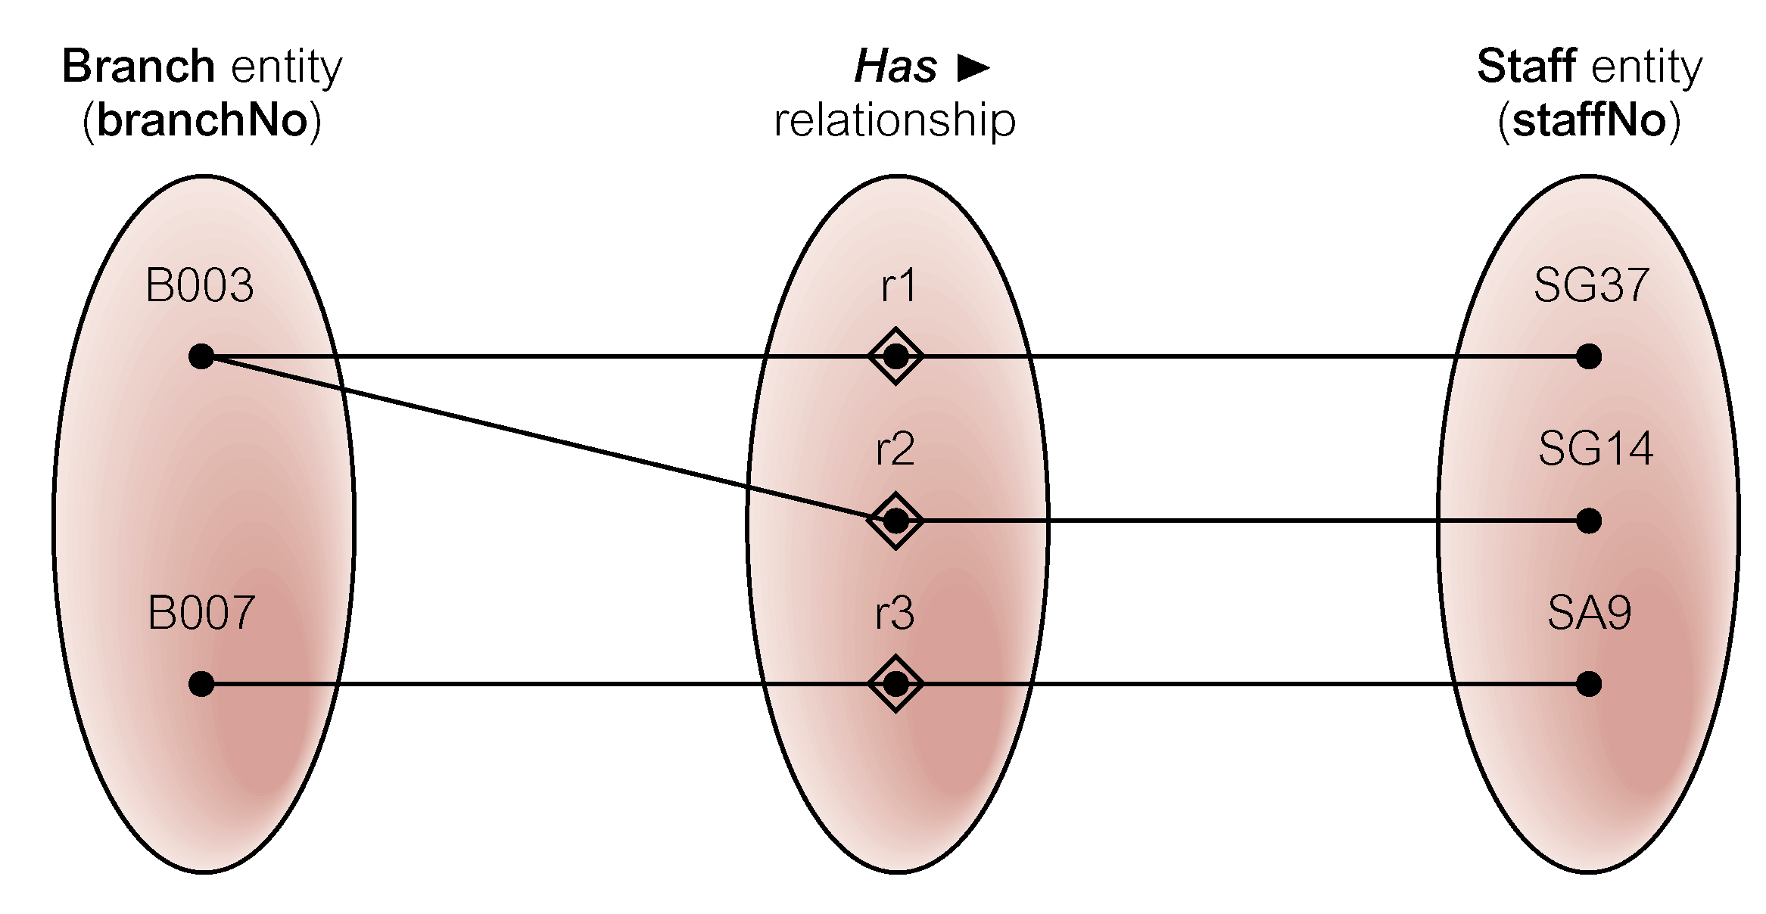
Semantic net of Has relationship type

Slide 21
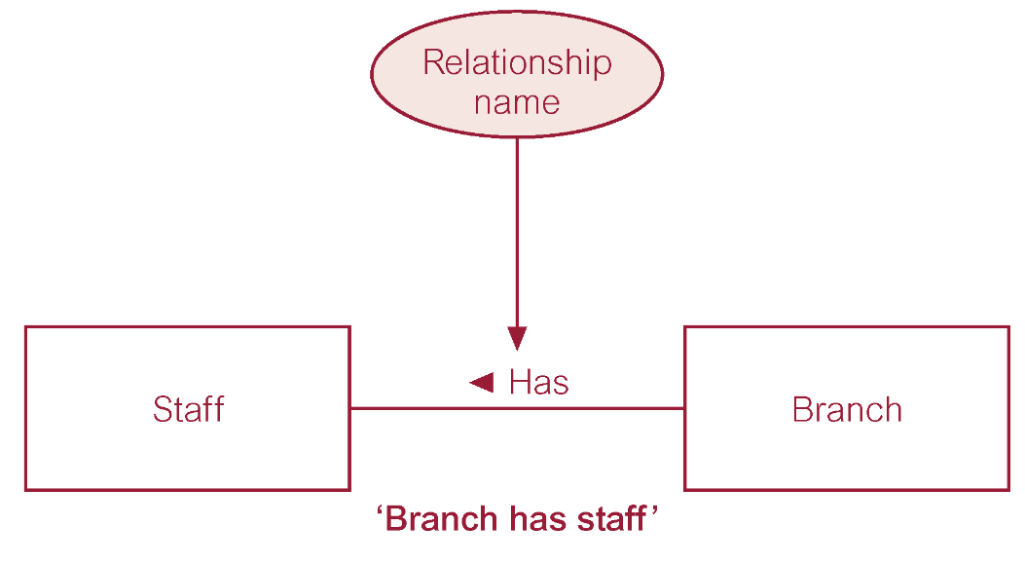
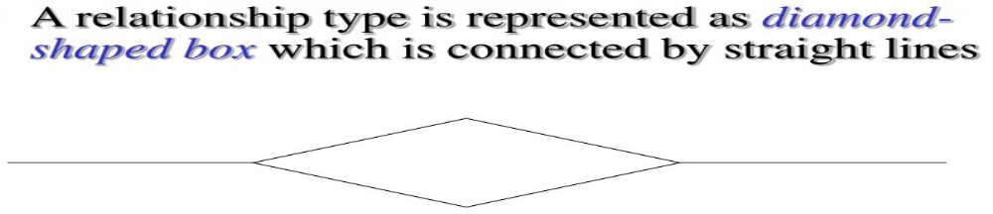

ER diagram of Branch Has Staff relationship

Slide 22
Relationship Types
Degree of a Relationship:
  Number of participating entities in relationship Type.
Relationship of degree :
  One is Unary
  two is binary
  three is ternary
  four is quaternary.

Slide 23

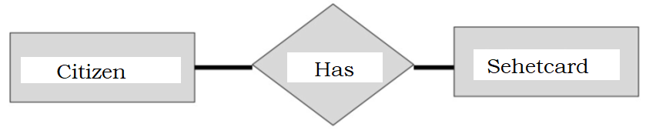
Binary relationship called POwns

Slide 24
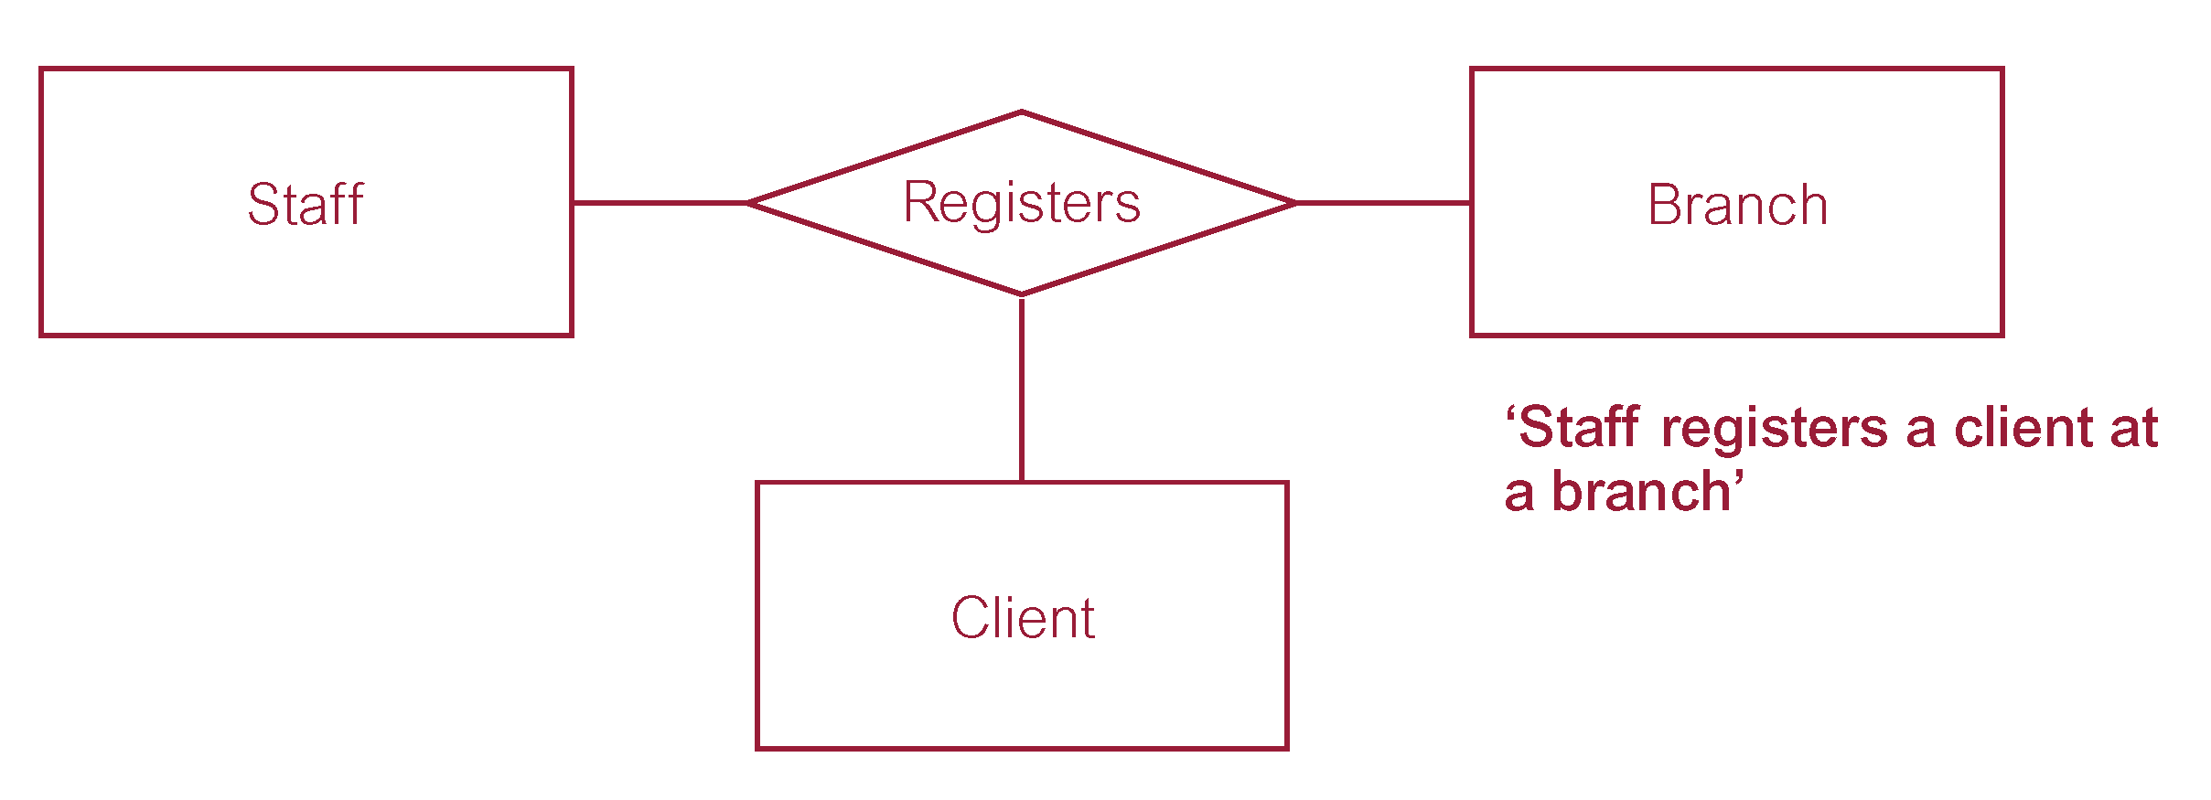
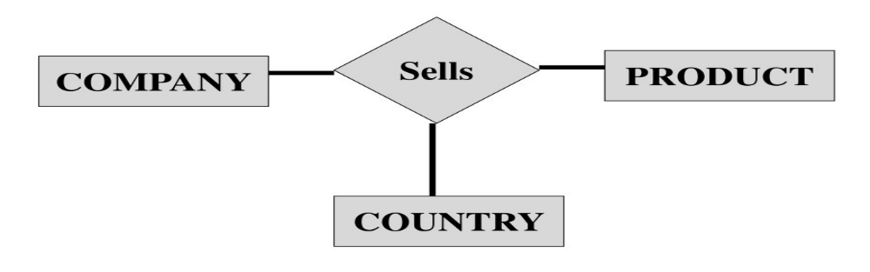
Ternary relationship called Registers

Slide 25
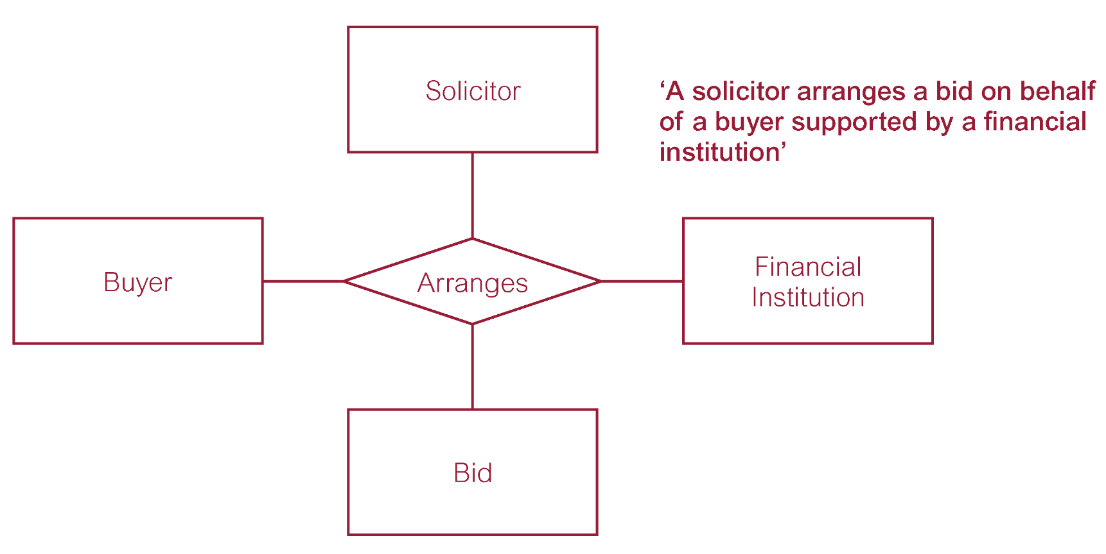
Quaternary relationship called Arranges

Slide 26
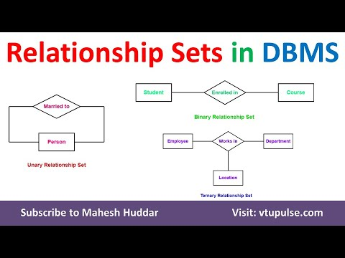

Slide 27
Relationship Types
Recursive Relationship:
  Relationship type where same entity type participates more than once in different roles.
Relationships may be given role names to indicate purpose that each participating entity type plays in a relationship.

Slide 28
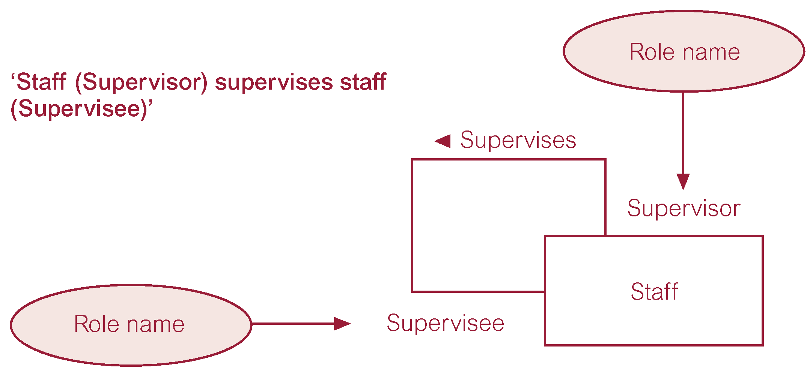
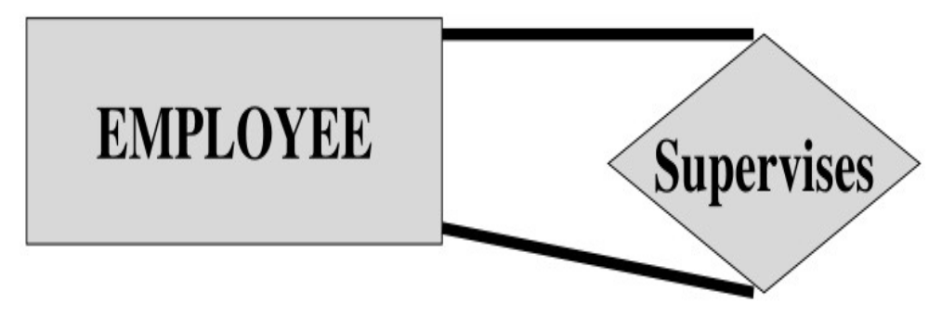
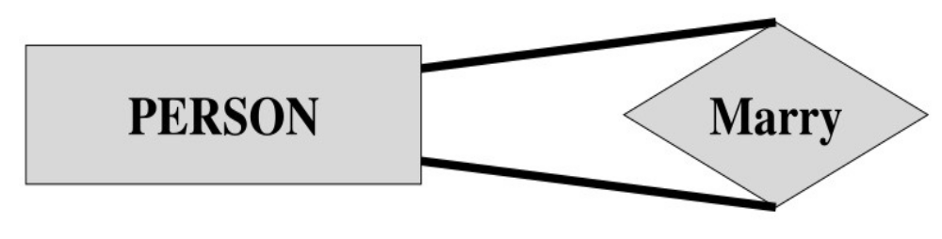
Recursive relationship called Supervises with role names

Slide 29
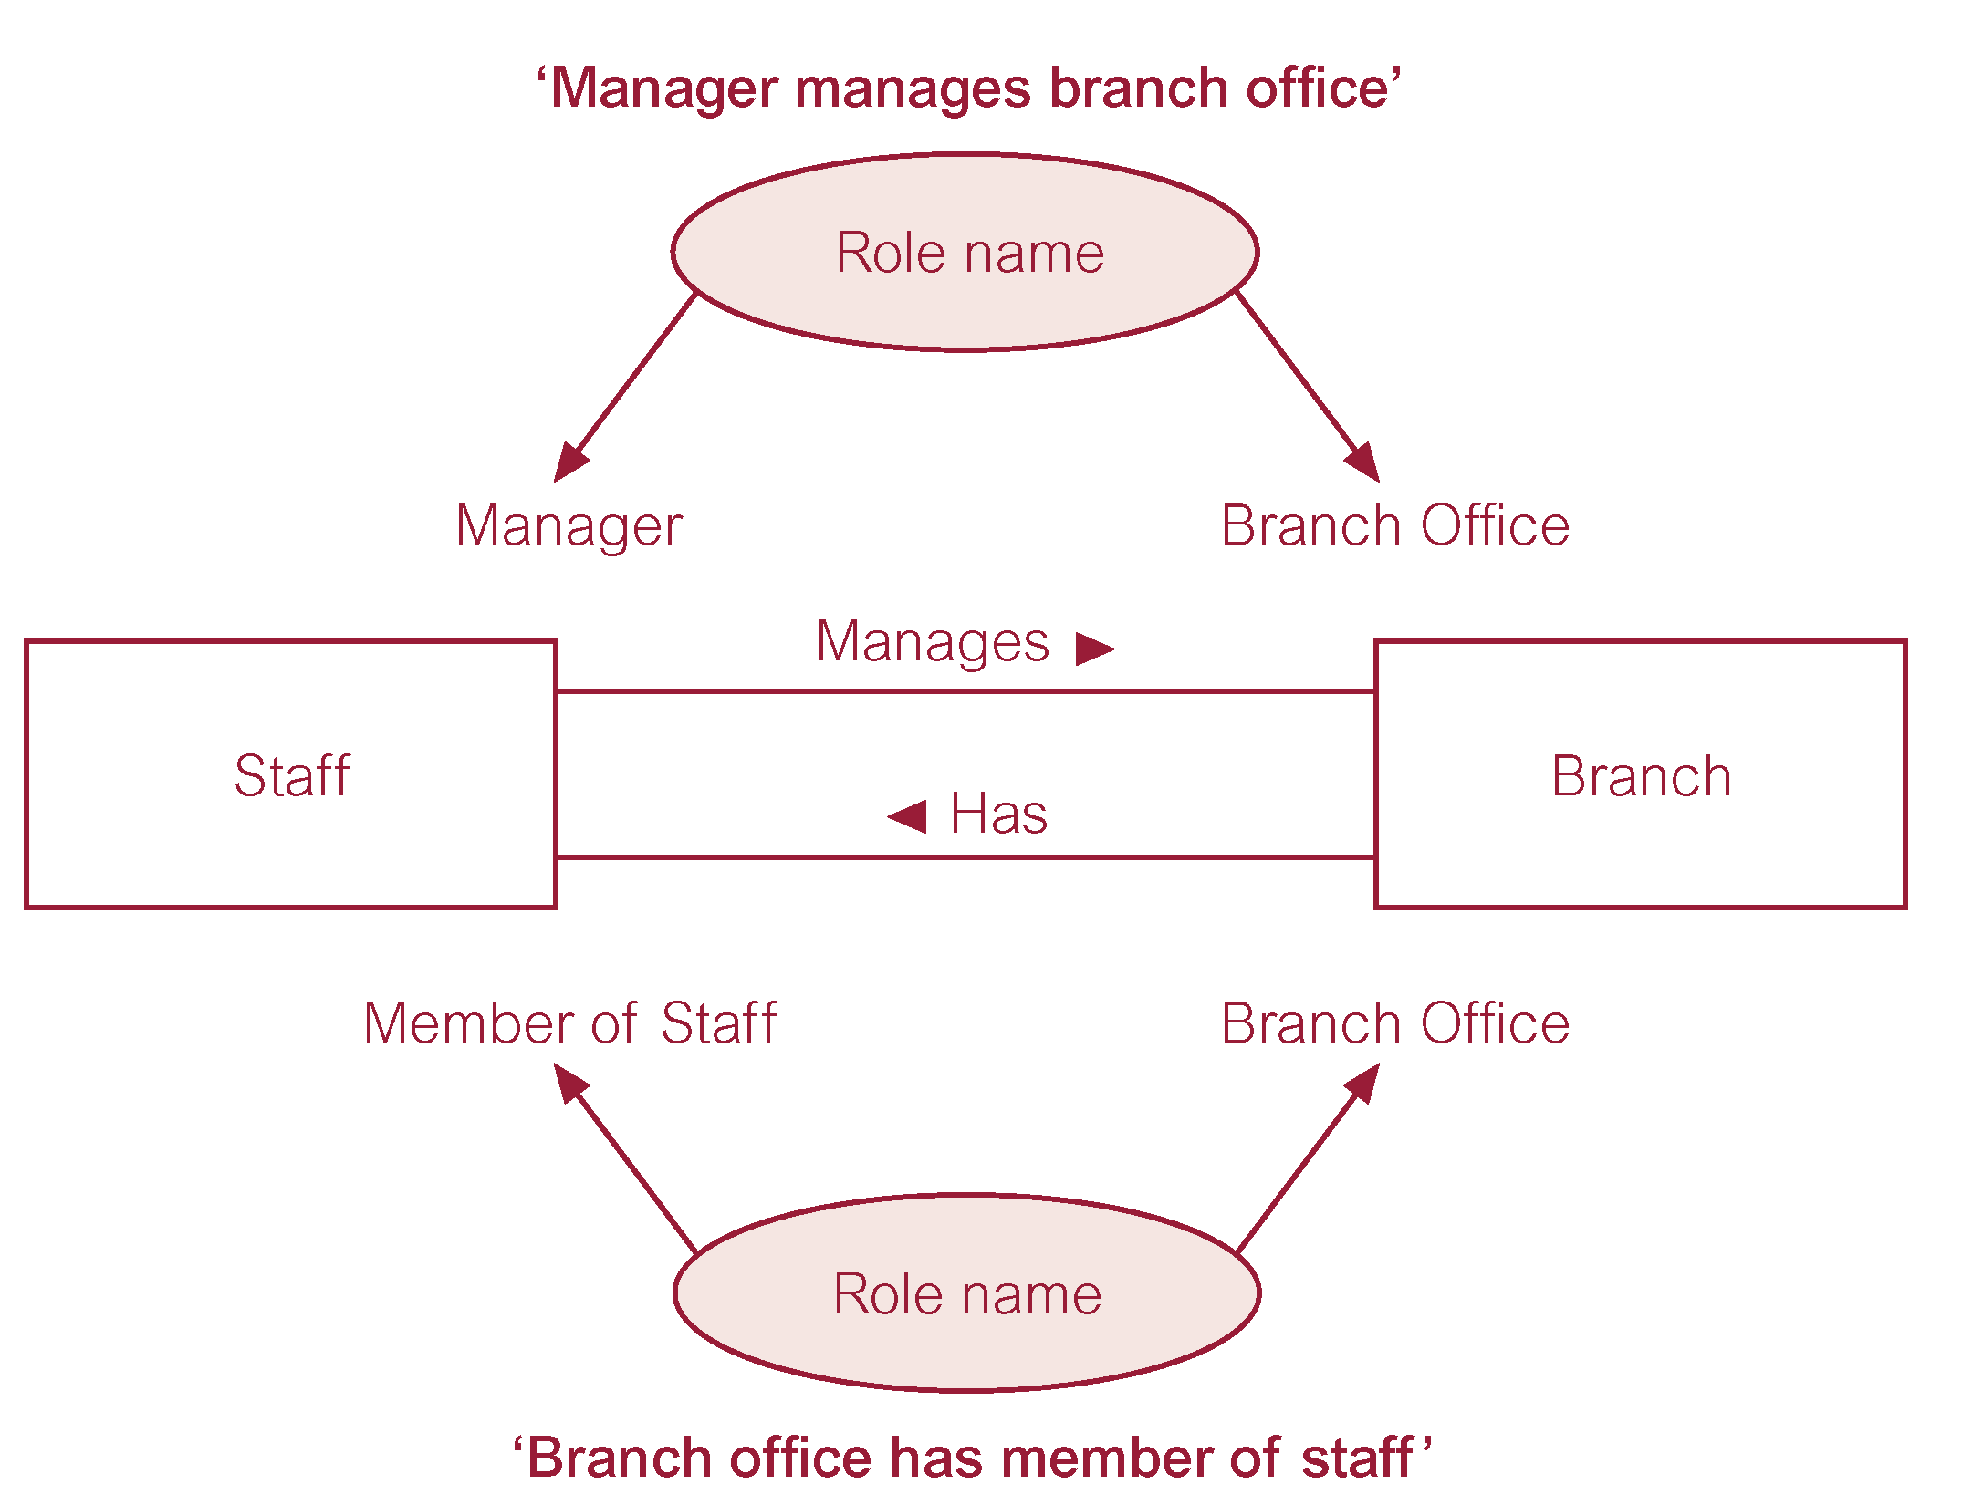
Entities associated through two distinct relationships with role names

Slide 30
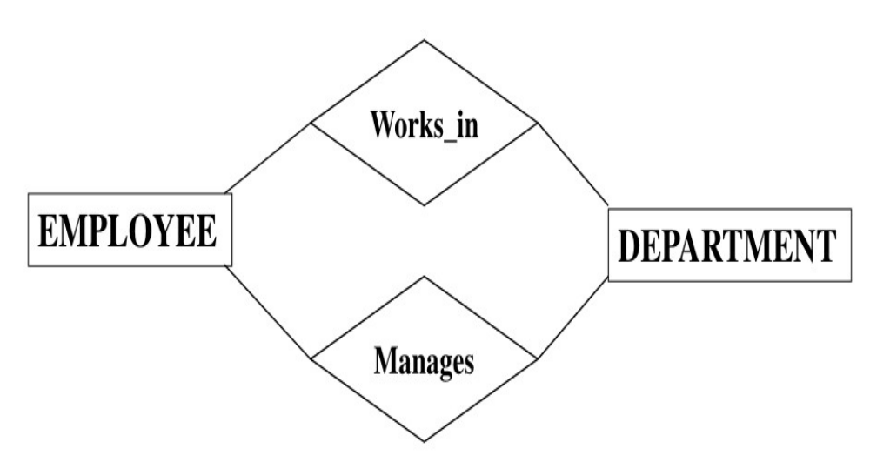
Entities associated through two distinct relationships with role names

Slide 31
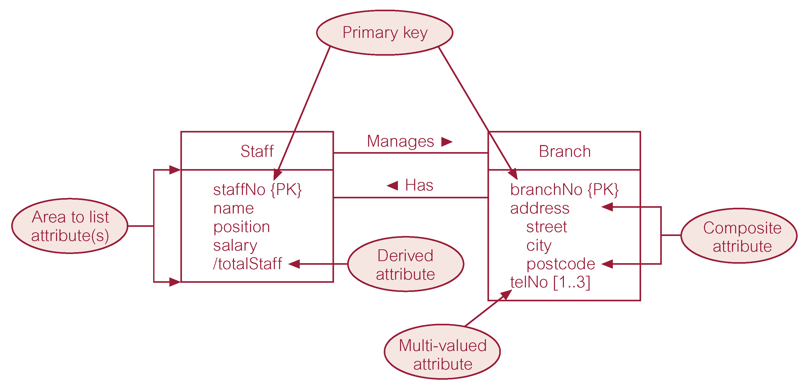
ER diagram of Staff and Branch entities and their attributes in UML Notations

Slide 32
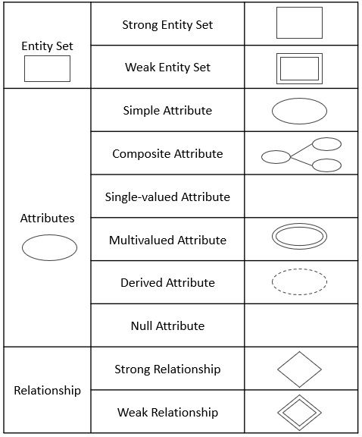
Other Notations

Slide 33
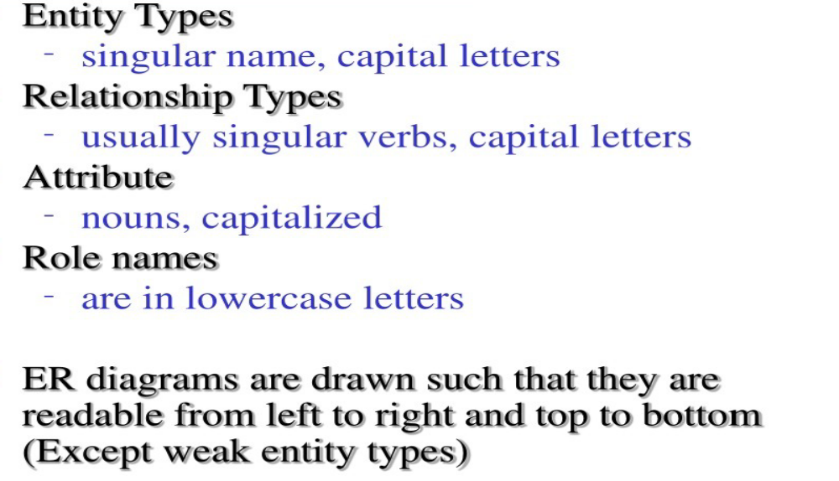
Notations

Slide 34
Keys
Candidate Key:
  Minimal set of attributes that uniquely identifies each occurrence of an entity type.
Primary Key:
  Candidate key selected to uniquely identify each occurrence of an entity type.
Composite Key:
  A candidate key that consists of two or more attributes.

Slide 35
Criteria for the selection of Primary Key
Minimal set of attributes:
  Simple key is prefered over composite key. Complex keys can make data manipulation and querying more difficult.
Numerical and Fixed-length Attributes:
  Choosing attributes with numeric or fixed-length values can enhance indexing and querying performance (i.e., increase efficiency).
Low prospect of loosing uniqueness in future:
  unchanged over time, ensuring that references to it from other tables remain valid. Changing key also triggers recalculation of indexes. Also requires rewriting of queries to retain efficiency.
Stable key:
  Not prone to frequent updates, it triggers cascade updates

Slide 36
Structural Constraints
Main type of constraint on relationships is called multiplicity.
Multiplicity - number (or range) of possible occurrences of an entity type that may relate to a single occurrence of an associated entity type through a particular relationship.
Represents policies (called business rules) established by user or company.

Slide 37
Structural Constraints
The most common degree for relationships is binary.
Binary relationships are generally referred to as being:
  one-to-one (1:1)
  one-to-many (1:*)
  many-to-many (*:*)

Slide 38
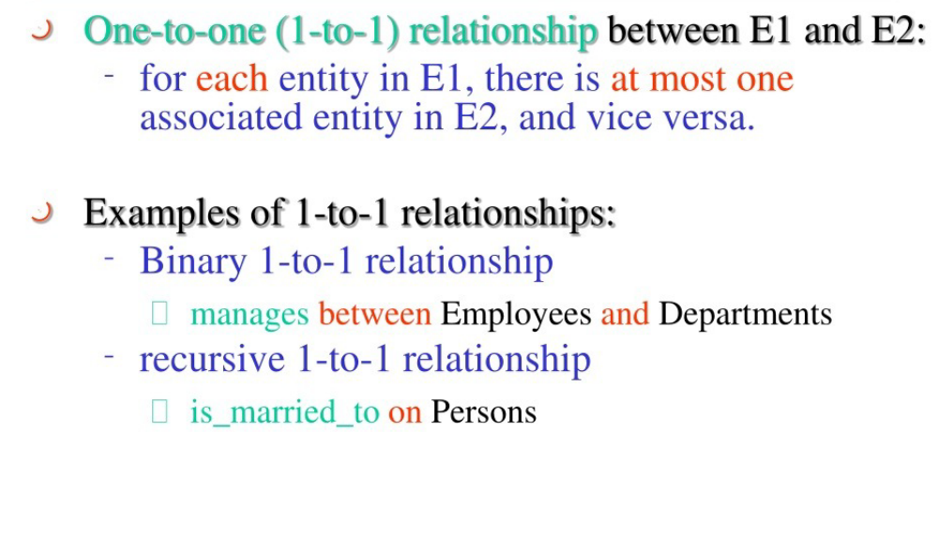
One-to-one relationship type

Slide 39
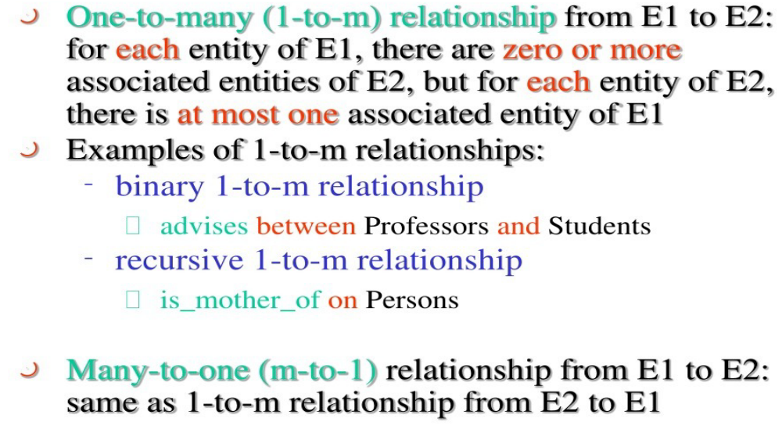
One-to-many relationship type

Slide 40
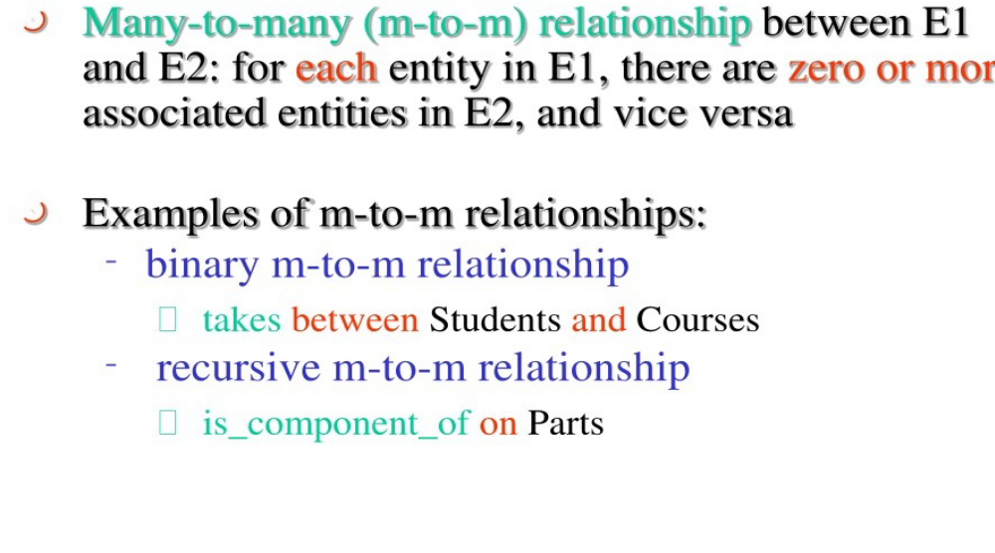
Many-to-many relationship type

Slide 41
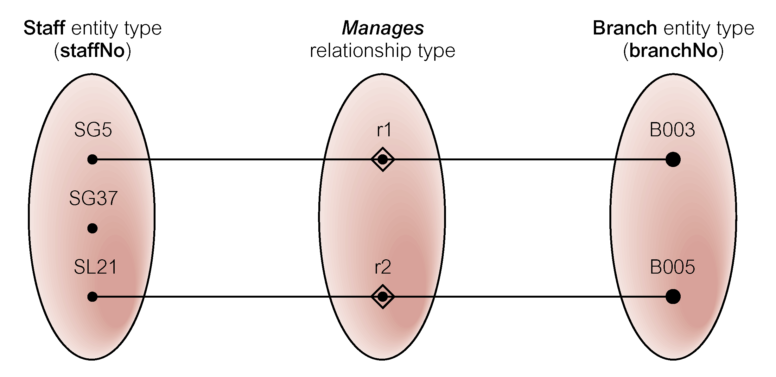
Semantic net of Staff Manages Branch relationship type

Slide 42
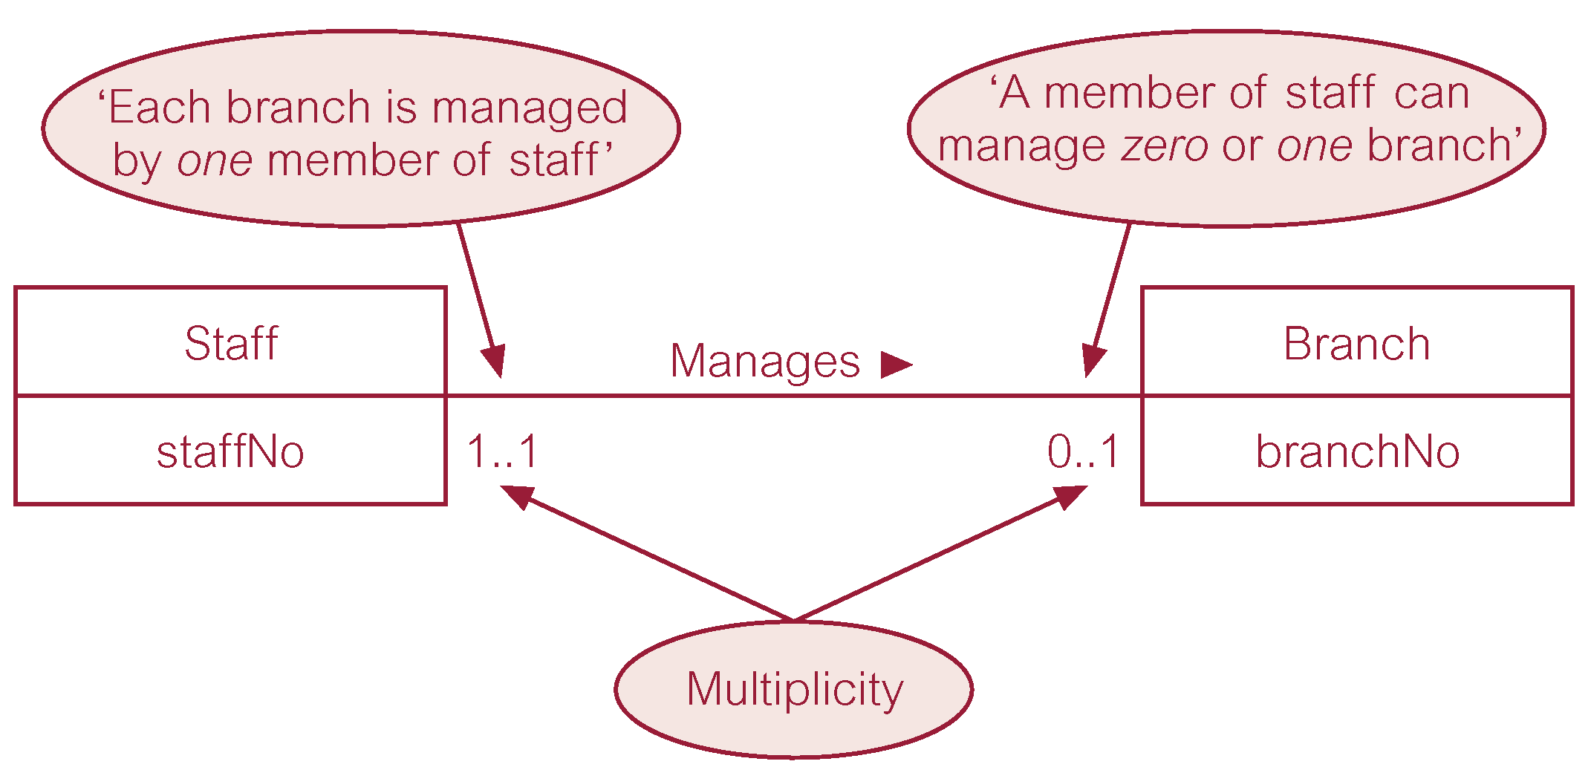
Multiplicity of Staff Manages Branch (1:1) relationship

Slide 43
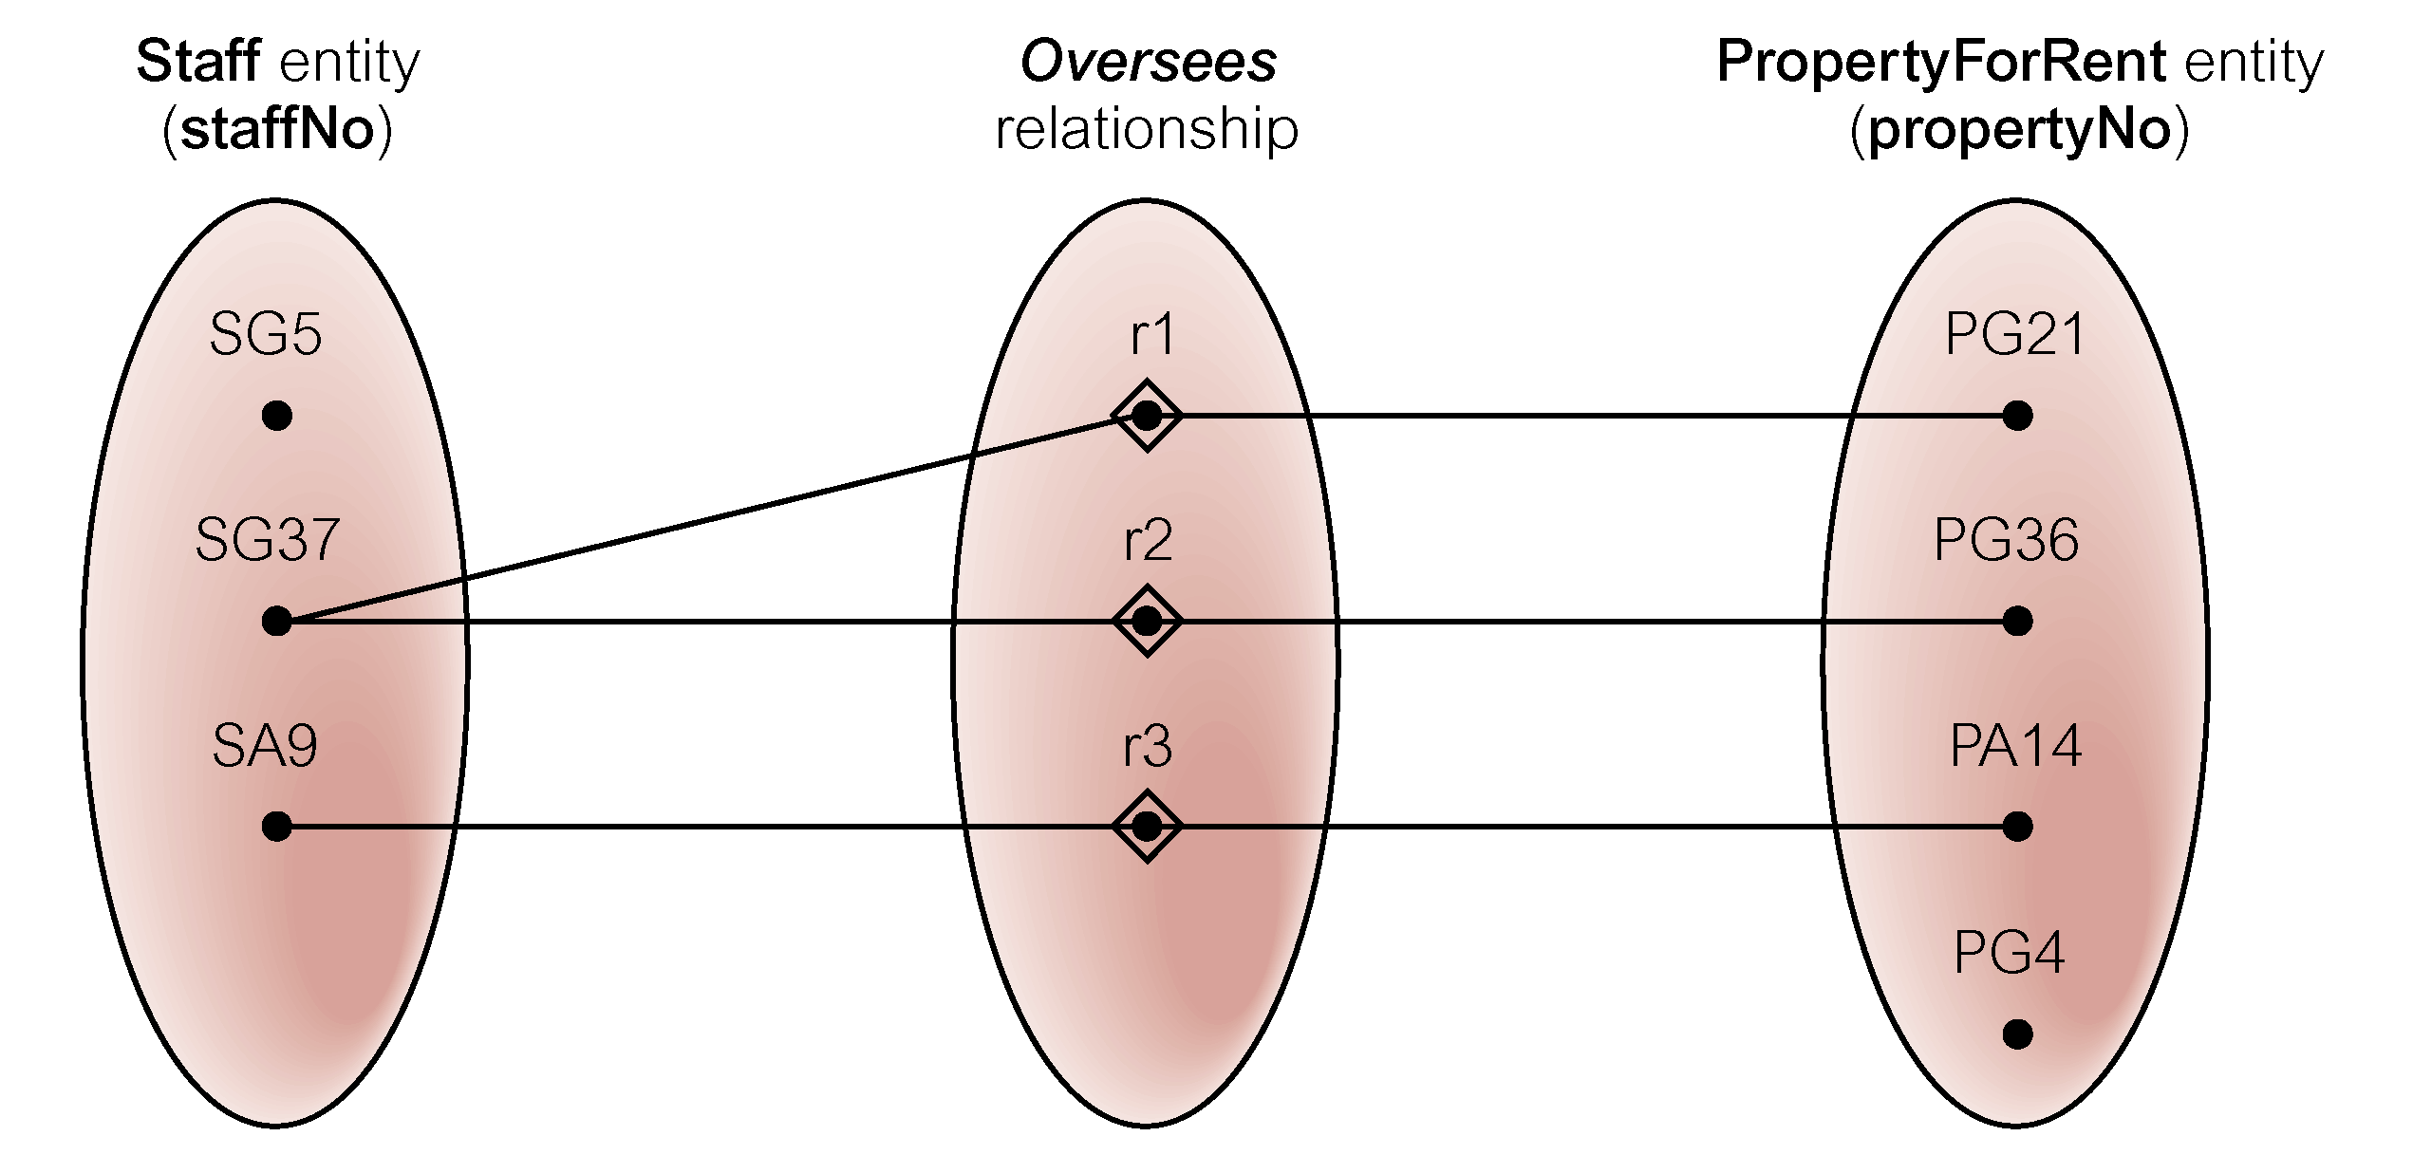
Semantic net of Staff Oversees PropertyForRent relationship type

Slide 44
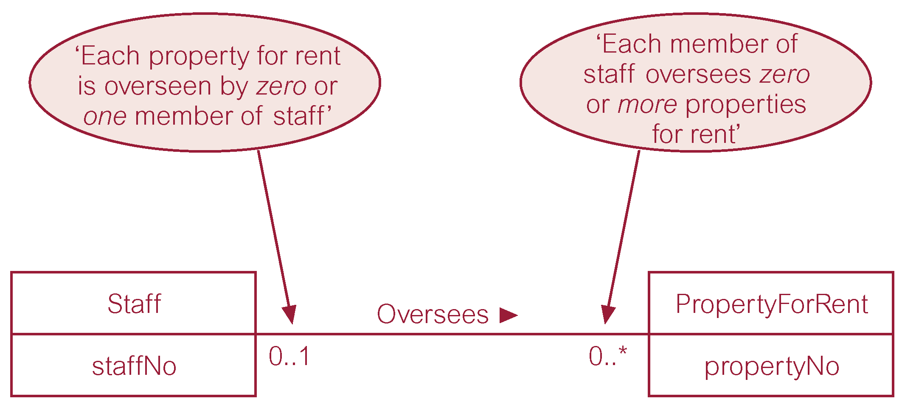
Multiplicity of Staff Oversees PropertyForRent (1:*) relationship type

Slide 45
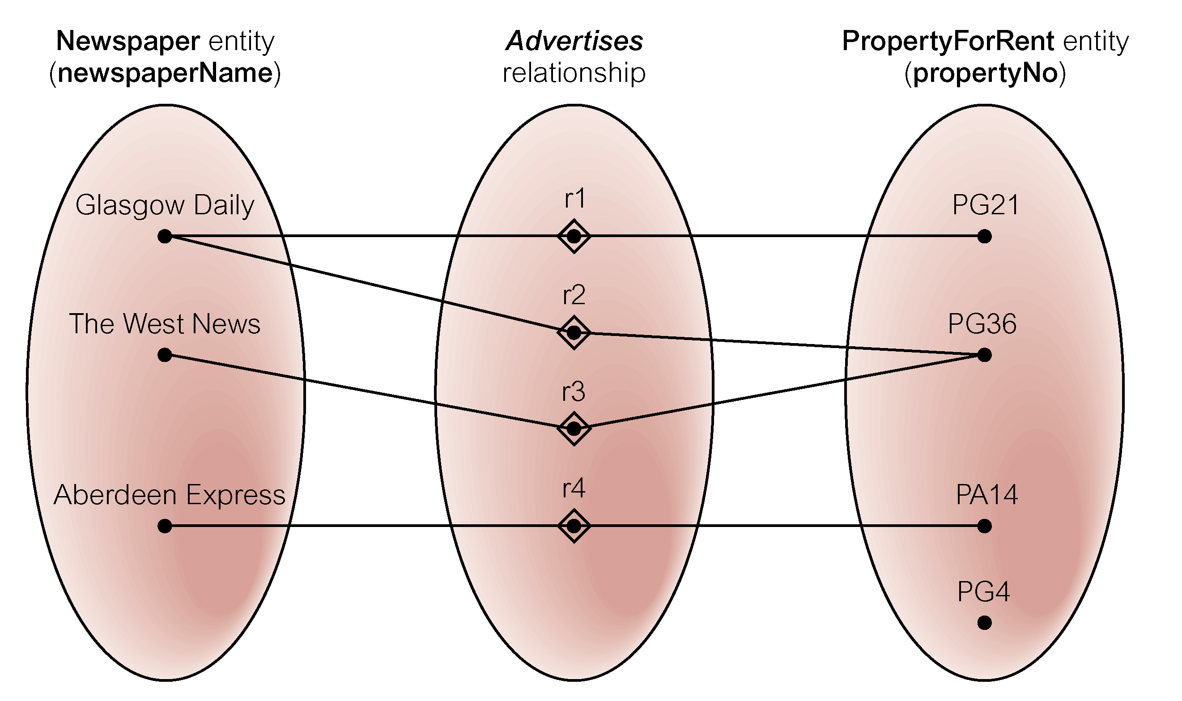
Semantic net of Newspaper Advertises PropertyForRent relationship type

Slide 46
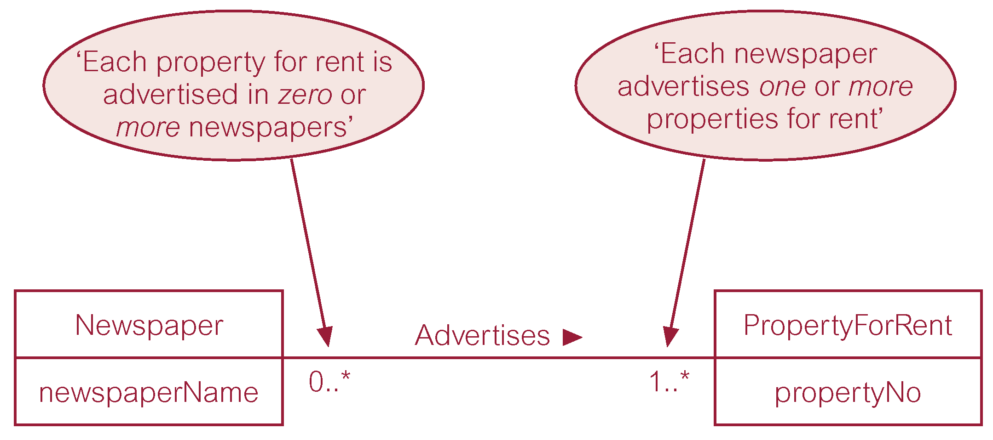
Multiplicity of Newspaper Advertises PropertyForRent (*:*) relationship

Slide 47
Structural Constraints
Multiplicity for Complex Relationships:
  Number (or range) of possible occurrences of an entity type in an n-ary relationship when other (n-1) values are fixed.

Slide 48
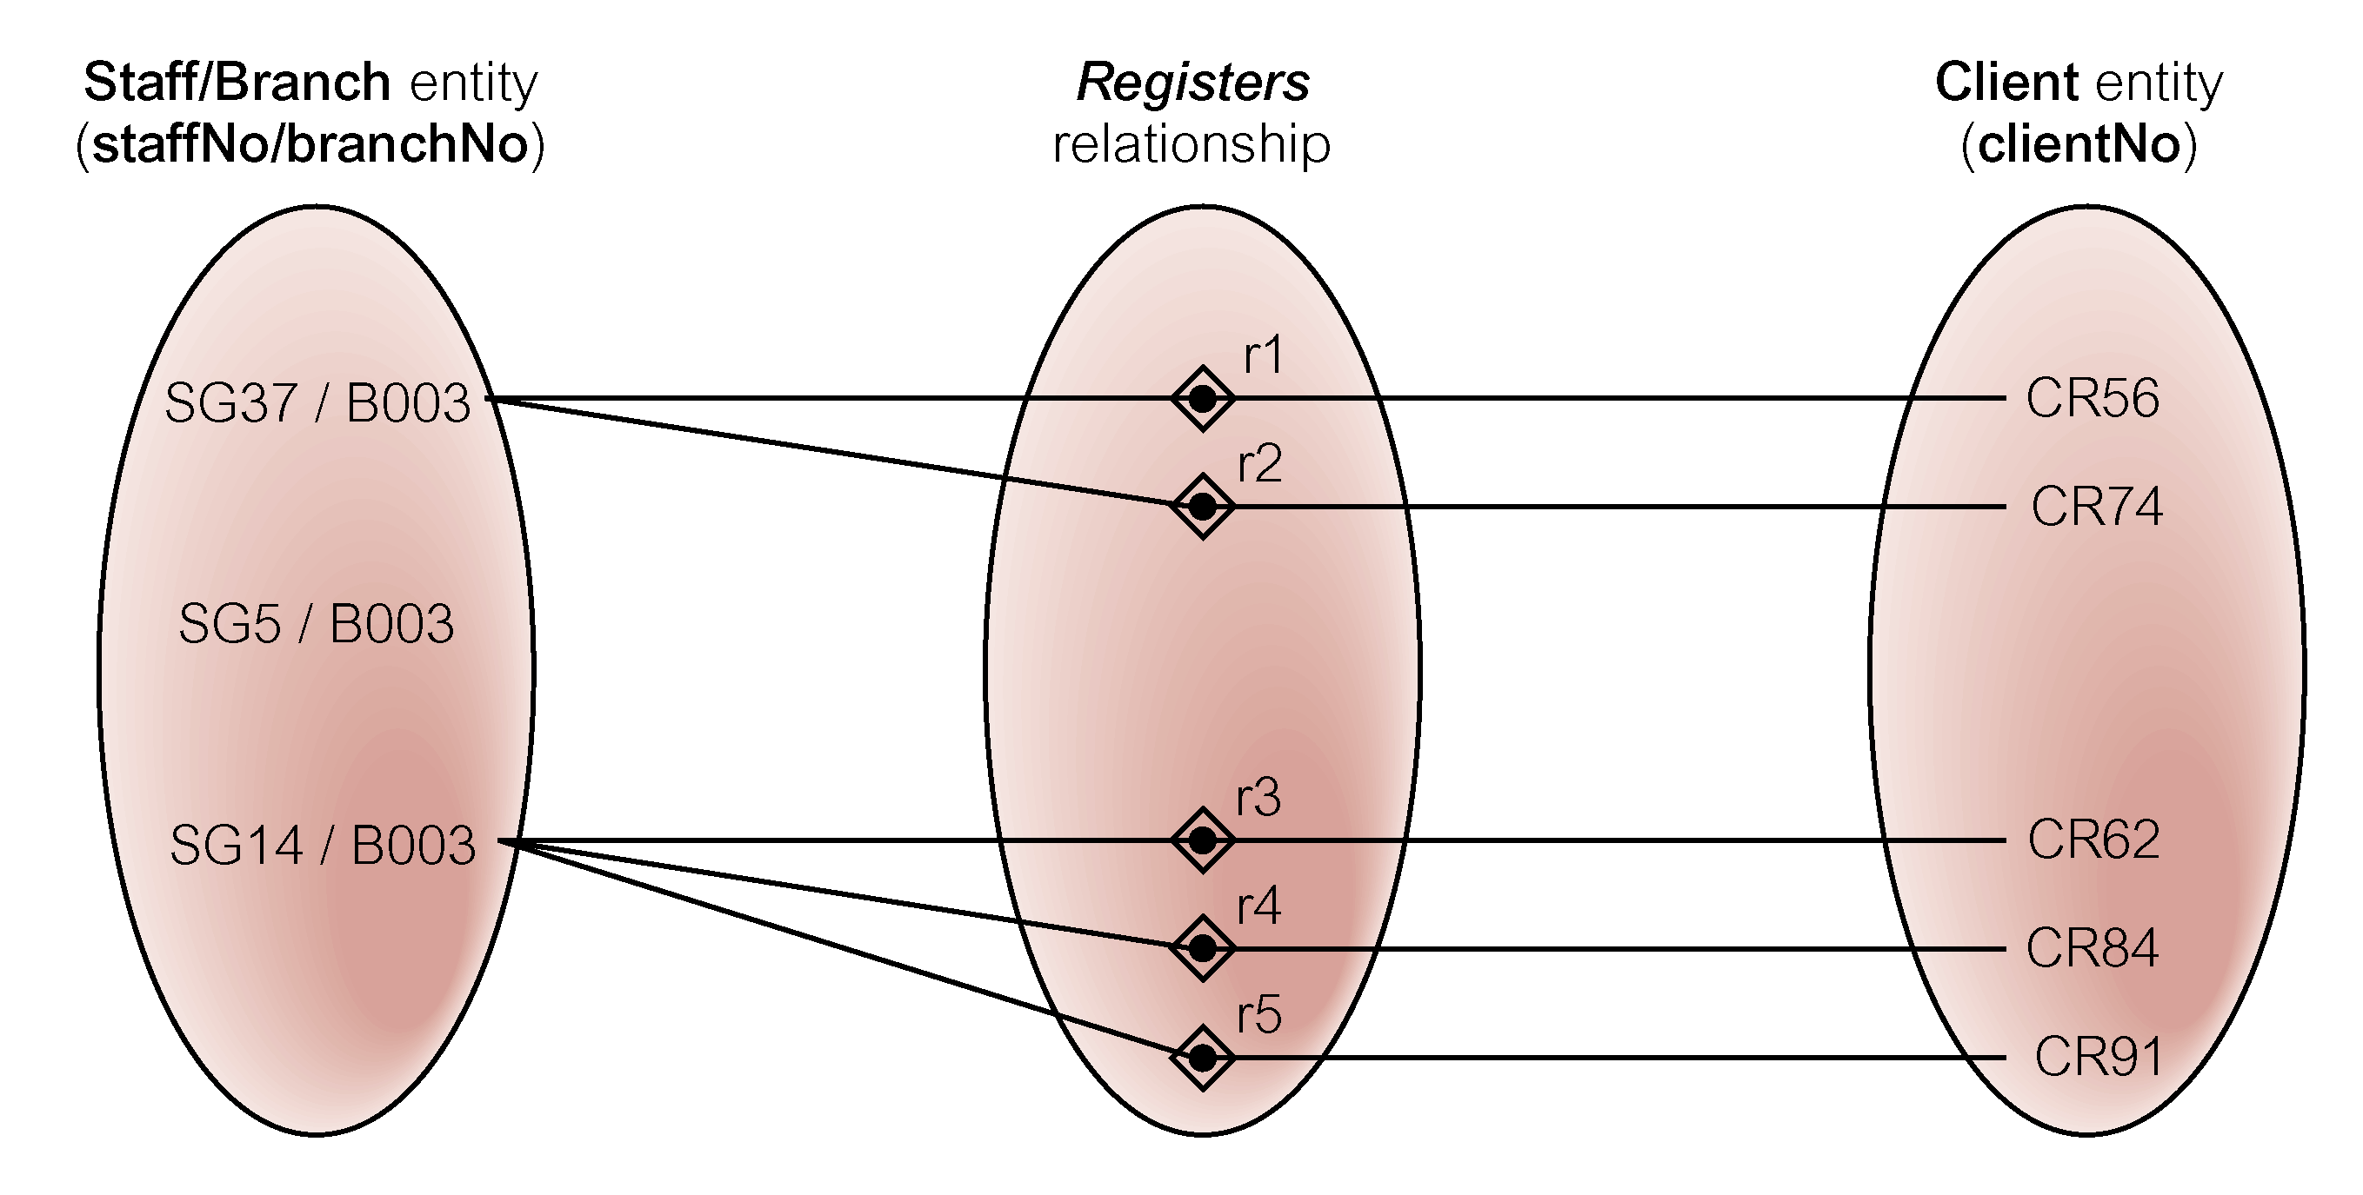
Semantic net of ternary Registers relationship with values for Staff and Branch entities fixed

Slide 49
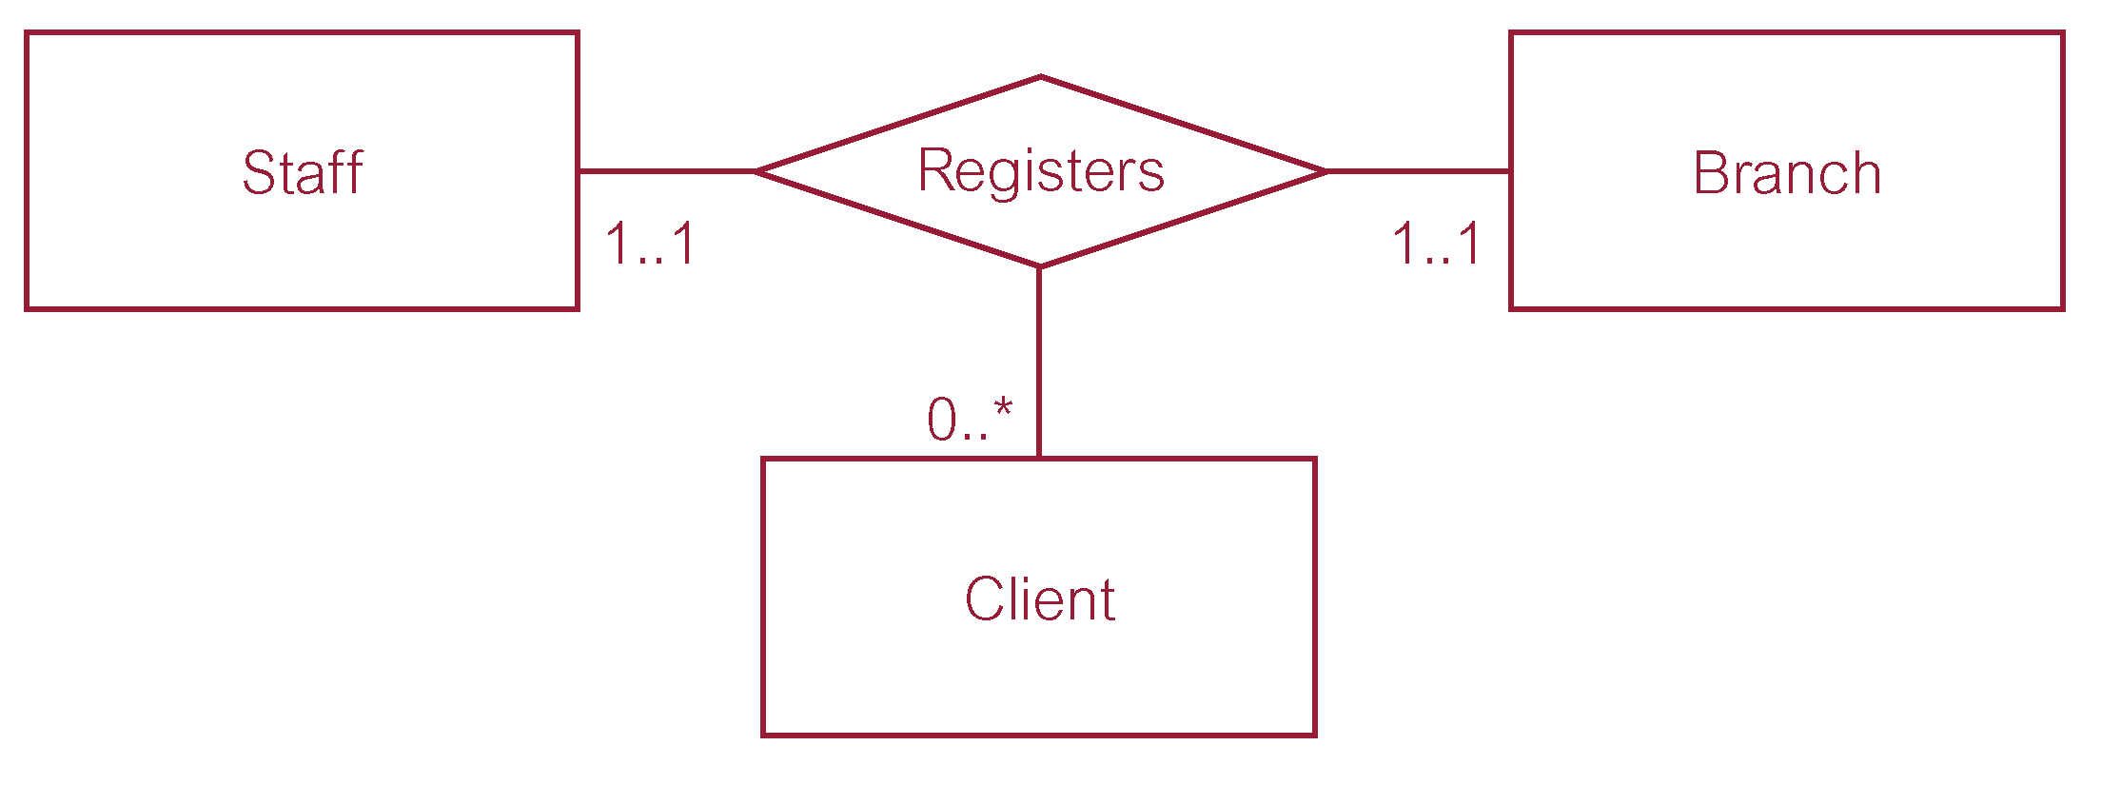
Multiplicity of ternary Registers relationship

Slide 50
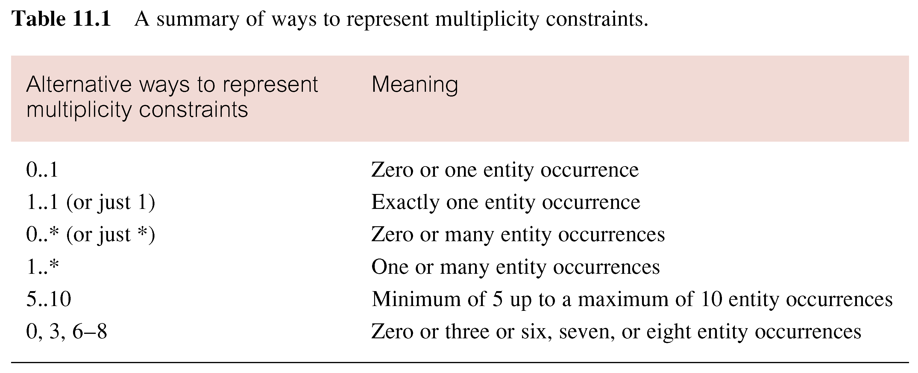
Summary of multiplicity constraints

Slide 51
Structural Constraints
Multiplicity is made up of two types of restrictions on relationships: cardinality and participation.
Cardinality:
  Describes maximum number of possible relationship occurrences for an entity participating in a given relationship type.
Participation:
  Determines whether all or only some entity occurrences participate in a relationship.

Slide 52
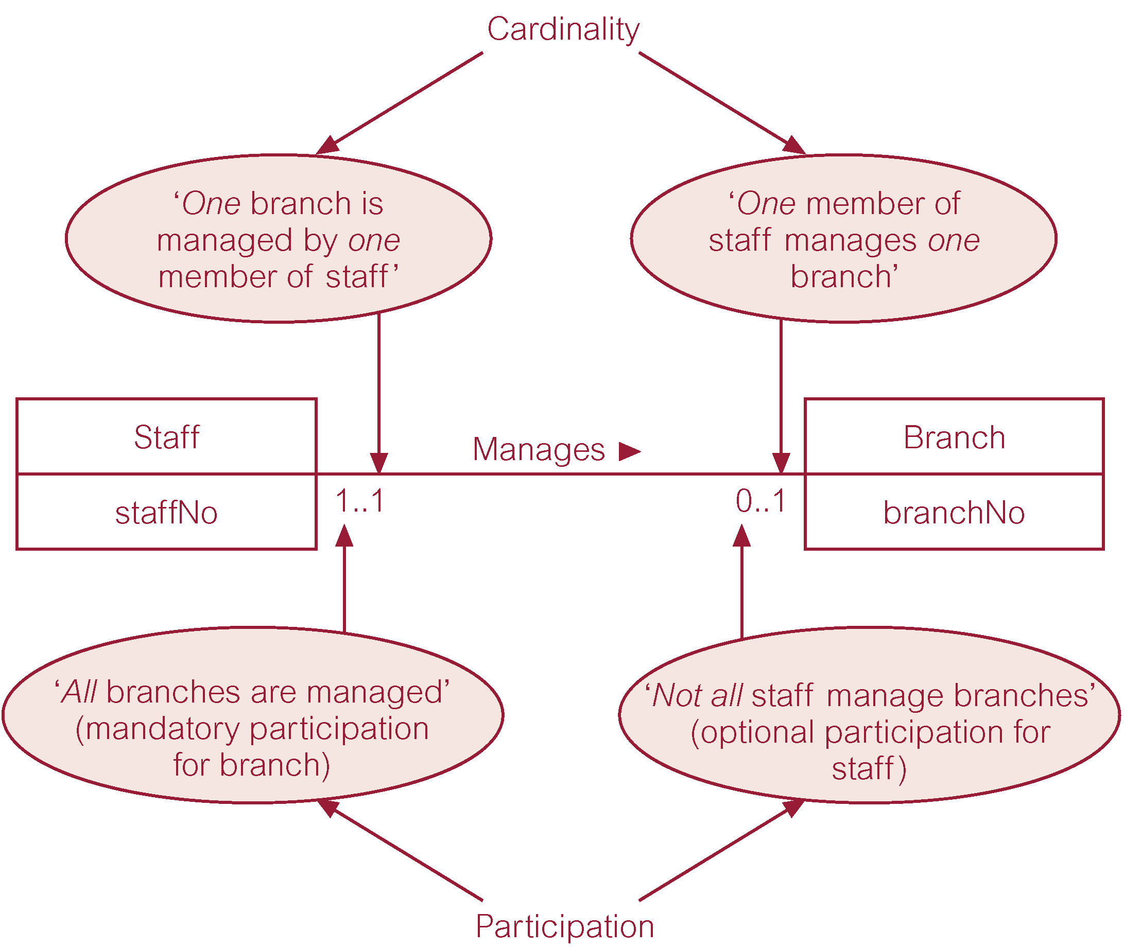
Multiplicity as cardinality and participation constraints

Slide 53
Types of an Entity Type
Strong Entity Type
  Entity type that is not existence-dependent on some other entity type.
Weak Entity Type
  Entity type that is existence-dependent on some other entity type.

Slide 54
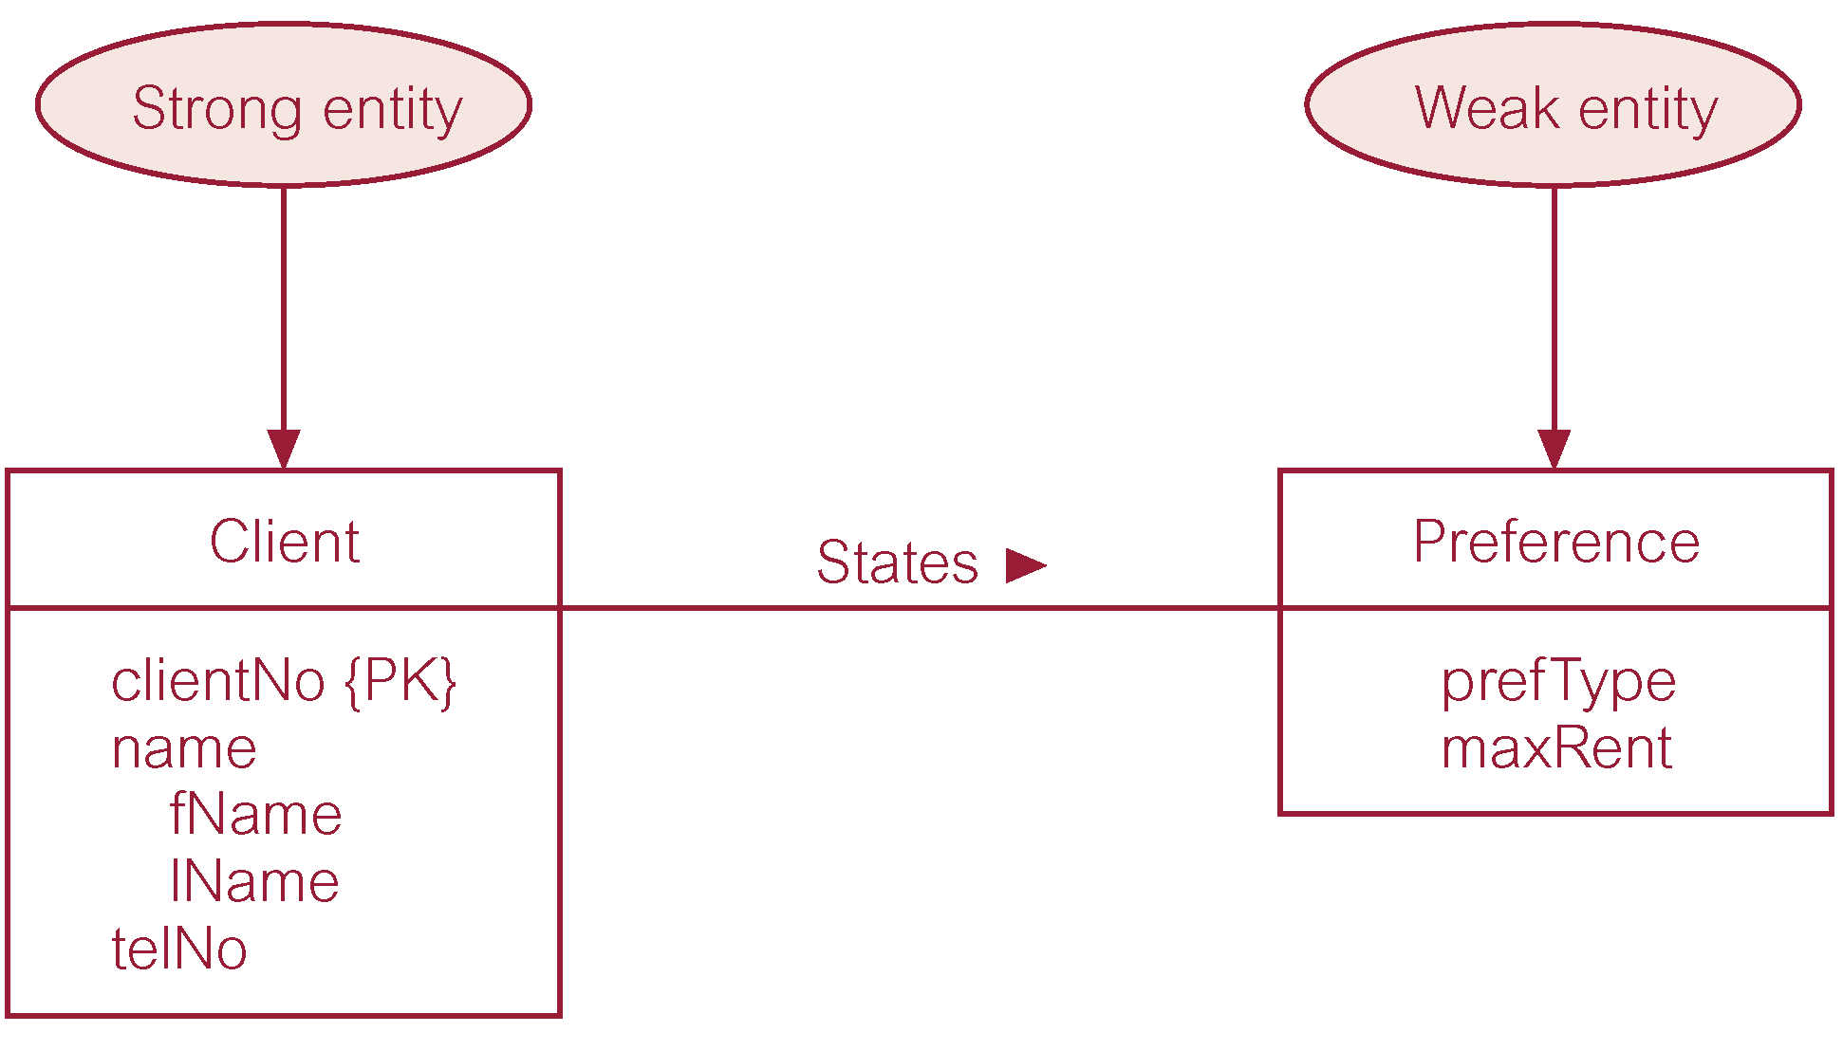
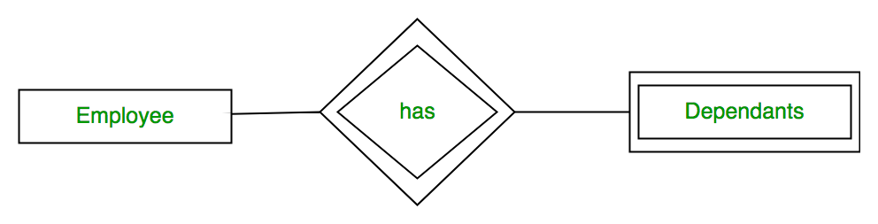
Weak Entity Type Examples

Slide 55
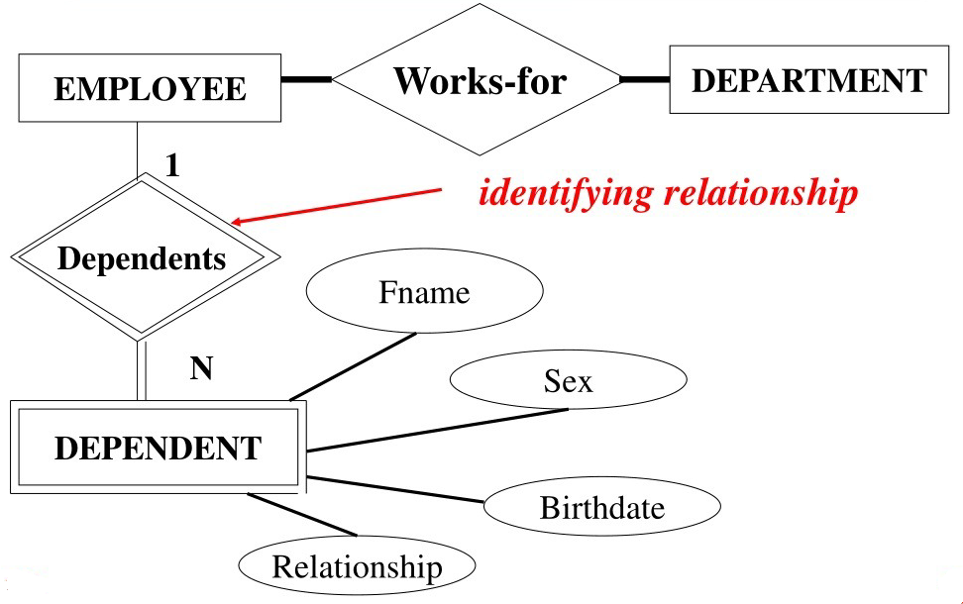
Weak Entity Type

Slide 56
Weak Entity Type
Weak entity type does not has key attribute(s)

Slide 57
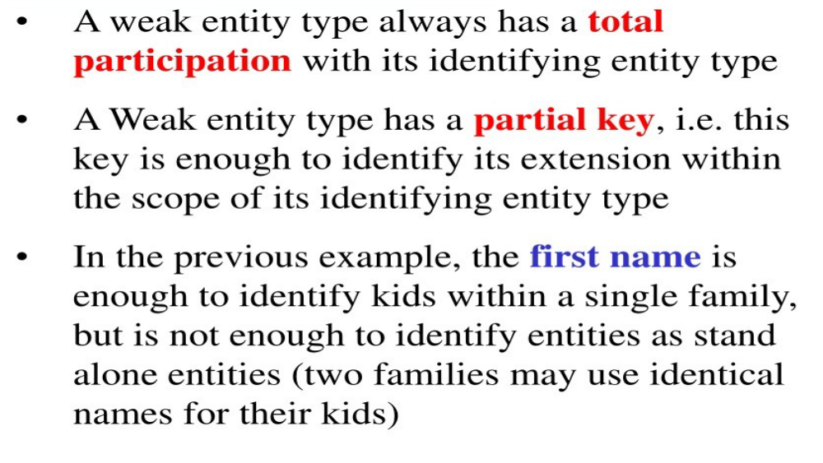
Weak Entity Type

Slide 58
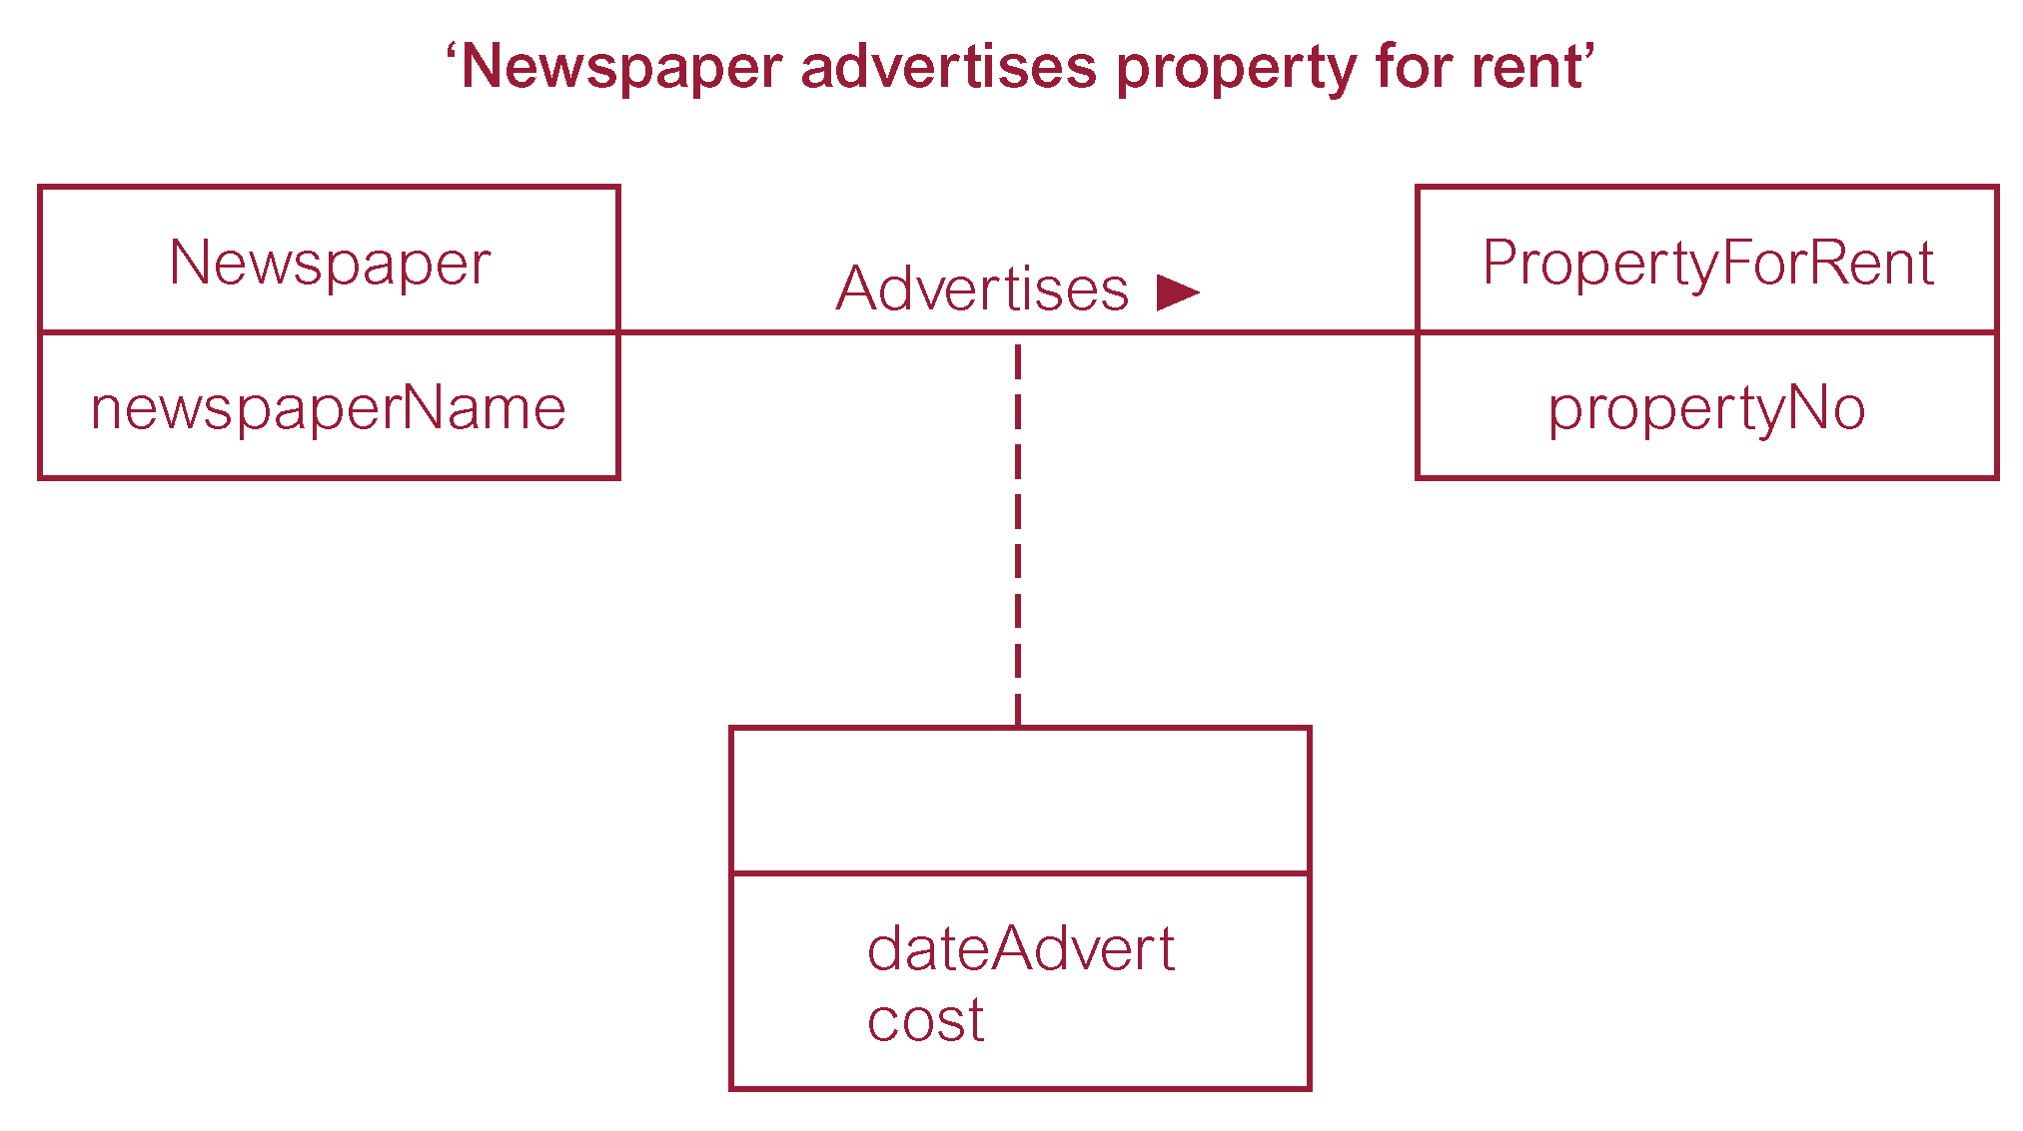
Relationship called Advertises with attributes

Slide 59
Lecture 11 – Further Objectives
How to identify and resolve problems with ER models called connection traps.

Slide 60
Problems with ER Models
Problems may arise when designing a conceptual data model called connection traps.
Often due to a misinterpretation of the meaning of certain relationships.
Two main types of connection traps are called fan traps and chasm traps.

Slide 61
Problems with ER Models
Fan Trap:
  Where a model represents a relationship between entity types, but pathway between certain entity occurrences is ambiguous.
Chasm Trap:
  Where a model suggests the existence of a relationship between entity types, but pathway does not exist between certain entity occurrences.

Slide 62

An Example of a Fan Trap

Slide 63
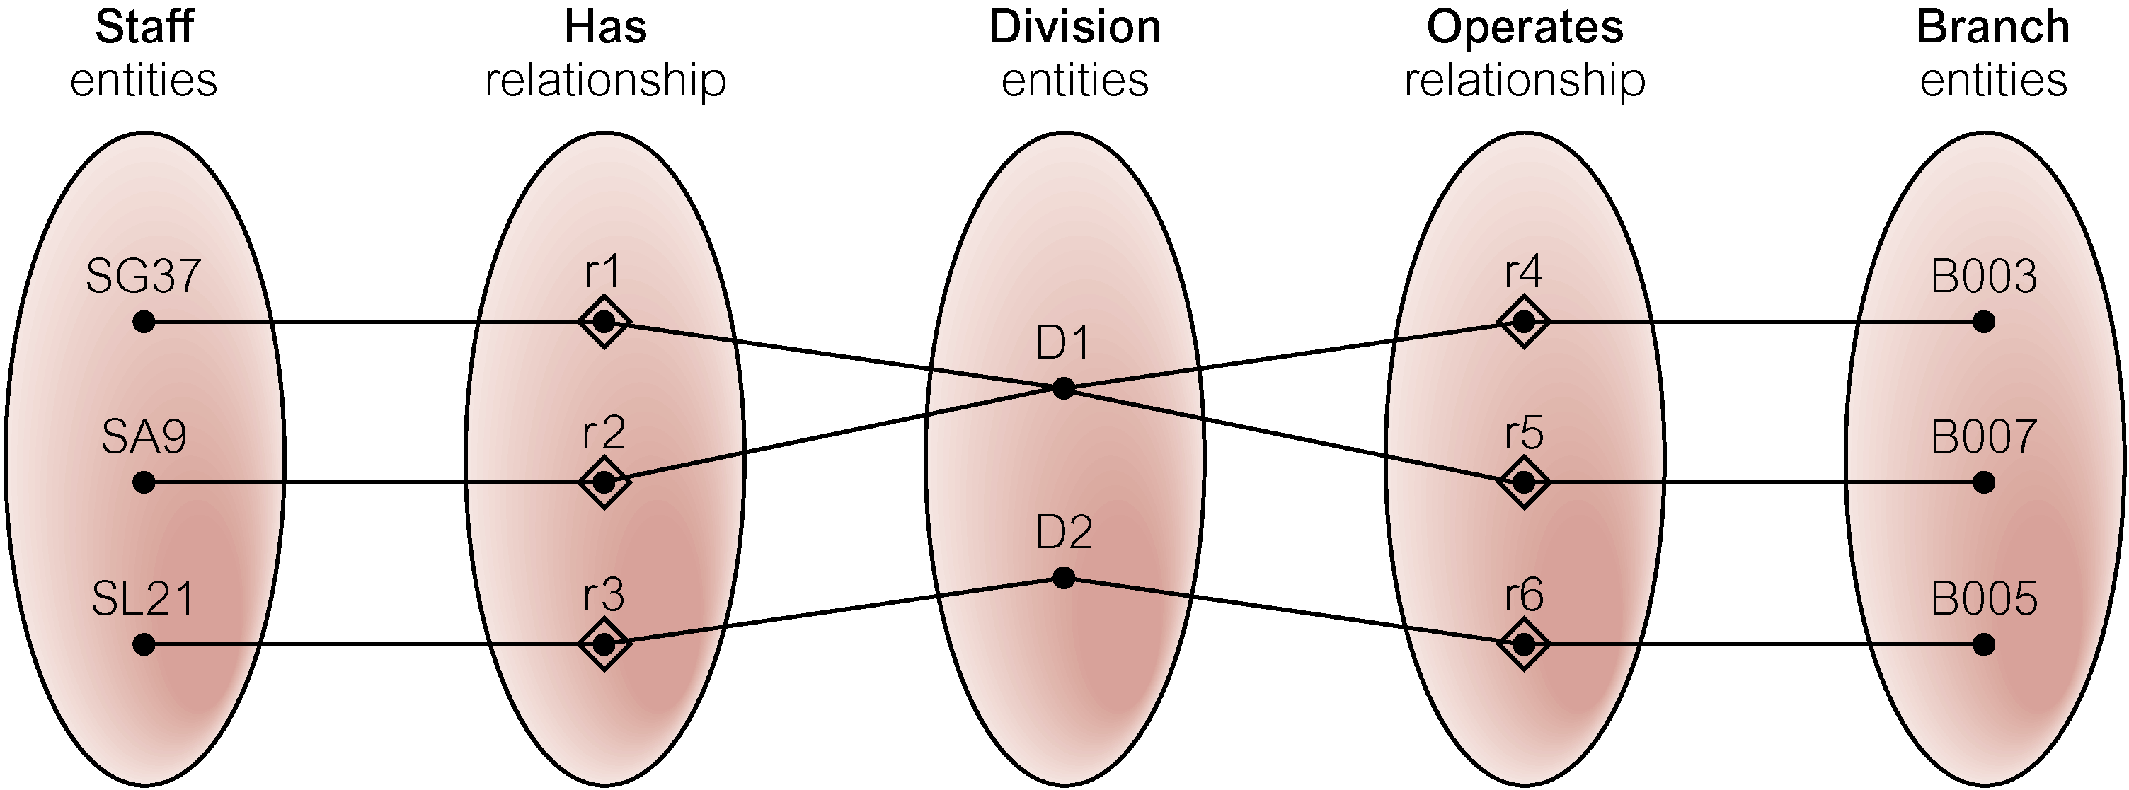
Semantic Net of ER Model with Fan Trap
At which branch office does staff number SG37 work?

Slide 64
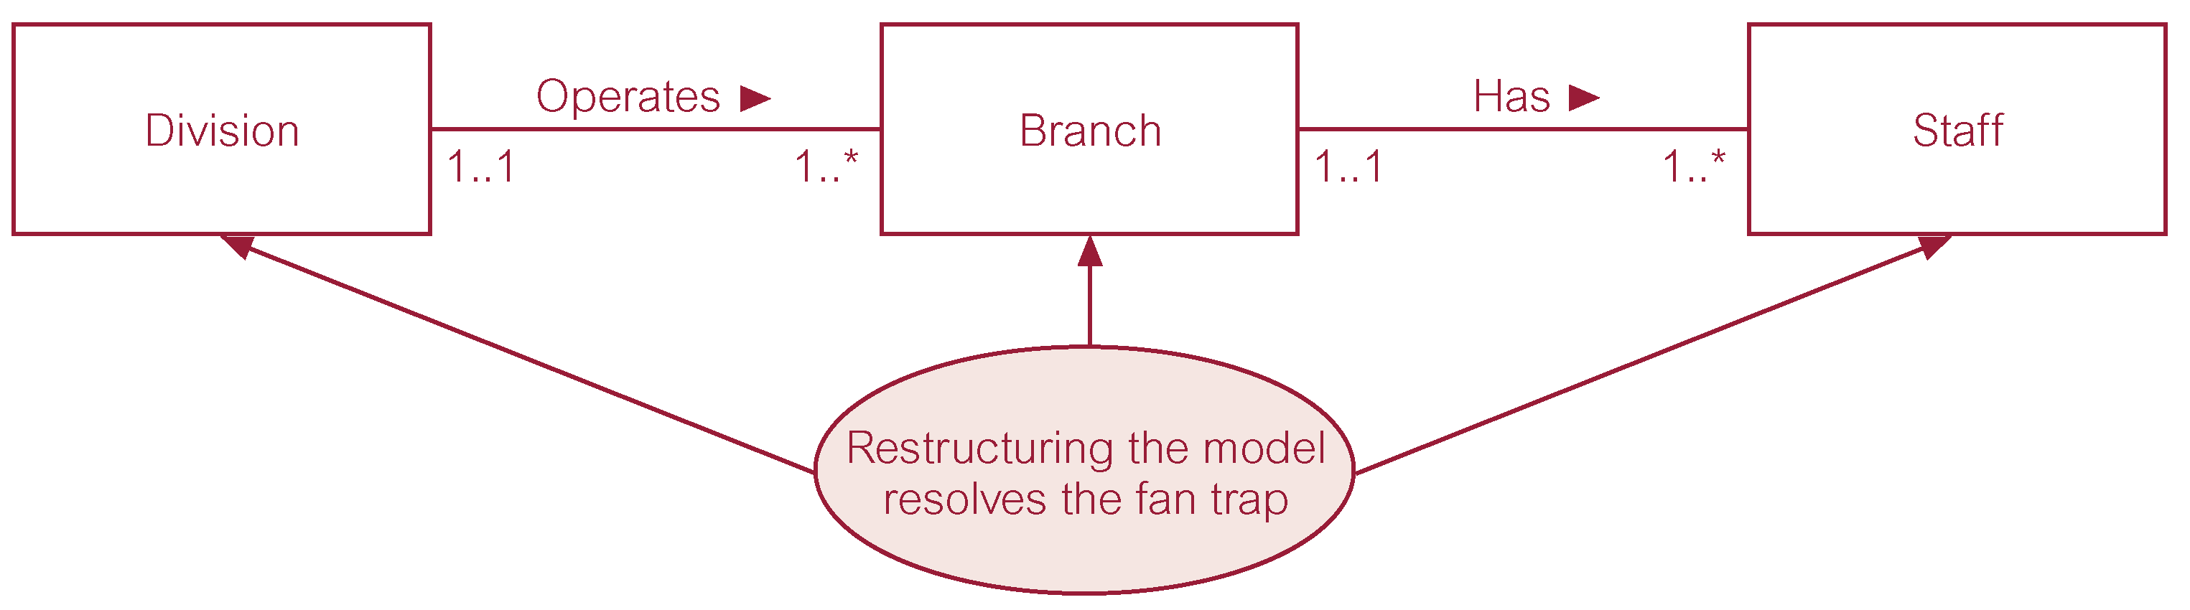
Restructuring ER model to remove Fan Trap

Slide 65
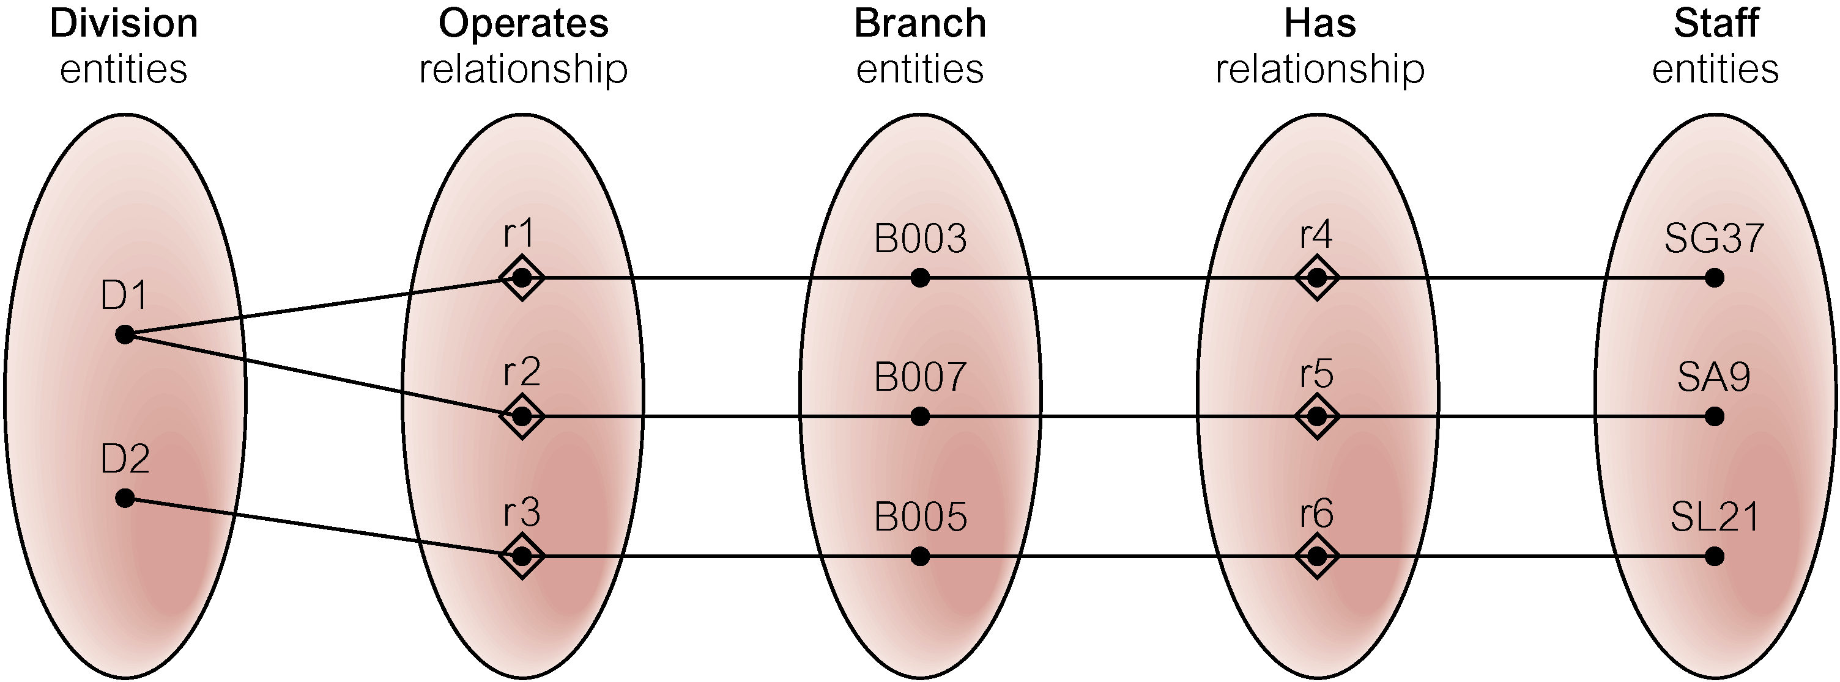
Semantic Net of Restructured ER Model with Fan Trap Removed
SG37 works at branch B003.

Slide 66

An Example of a Chasm Trap

Slide 67
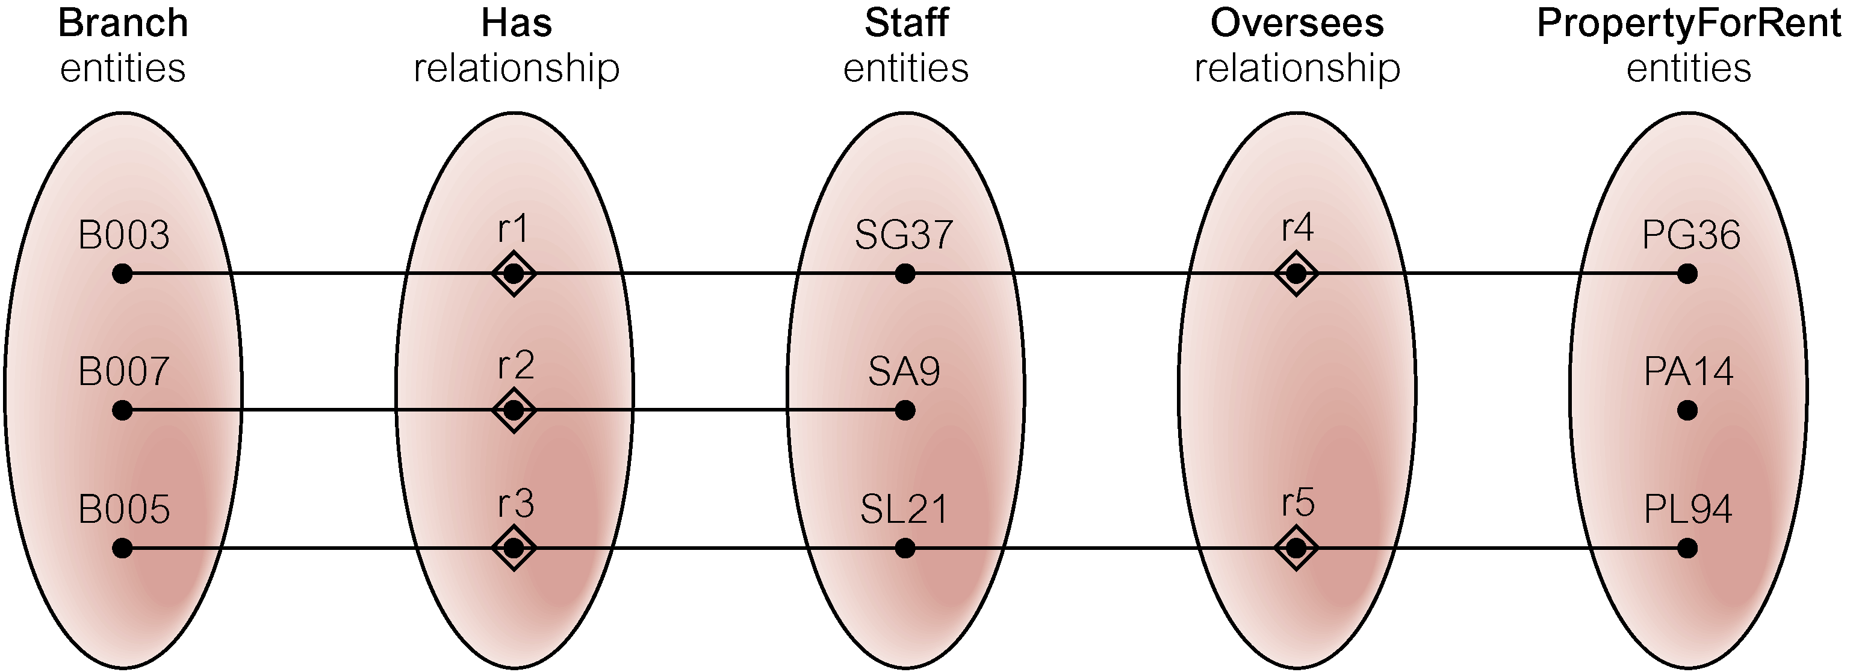
Semantic Net of ER Model with Chasm Trap
At which branch office is property PA14 available?

Slide 68
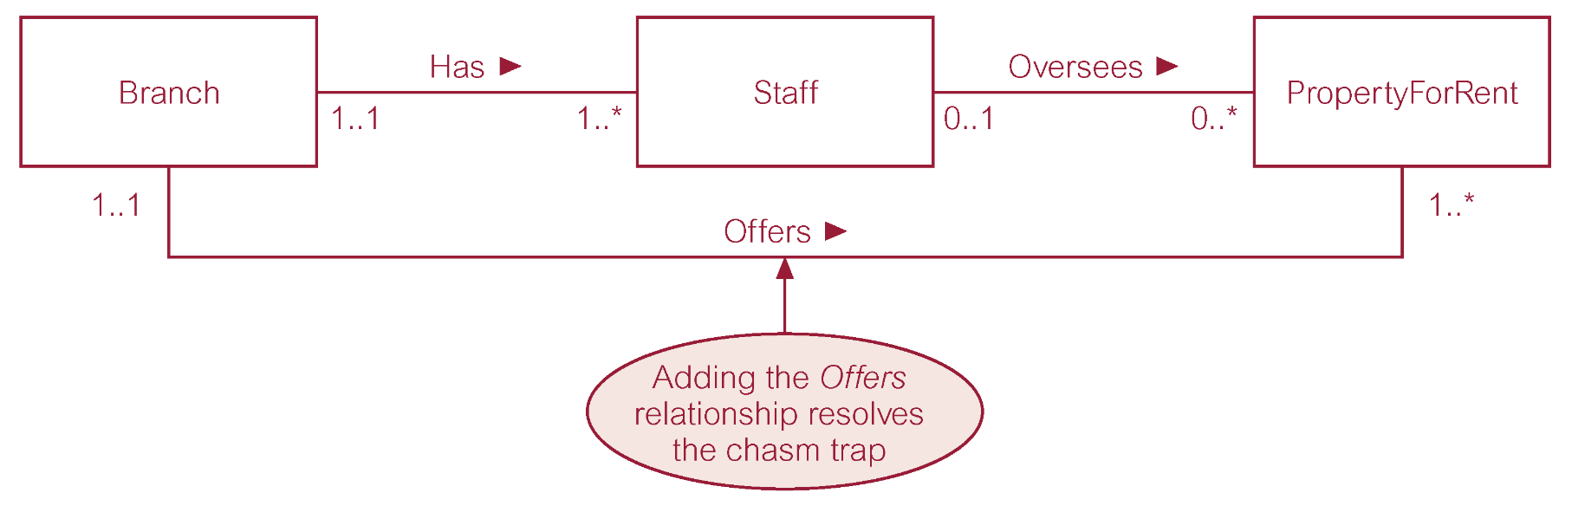
ER Model restructured to remove Chasm Trap

Slide 69
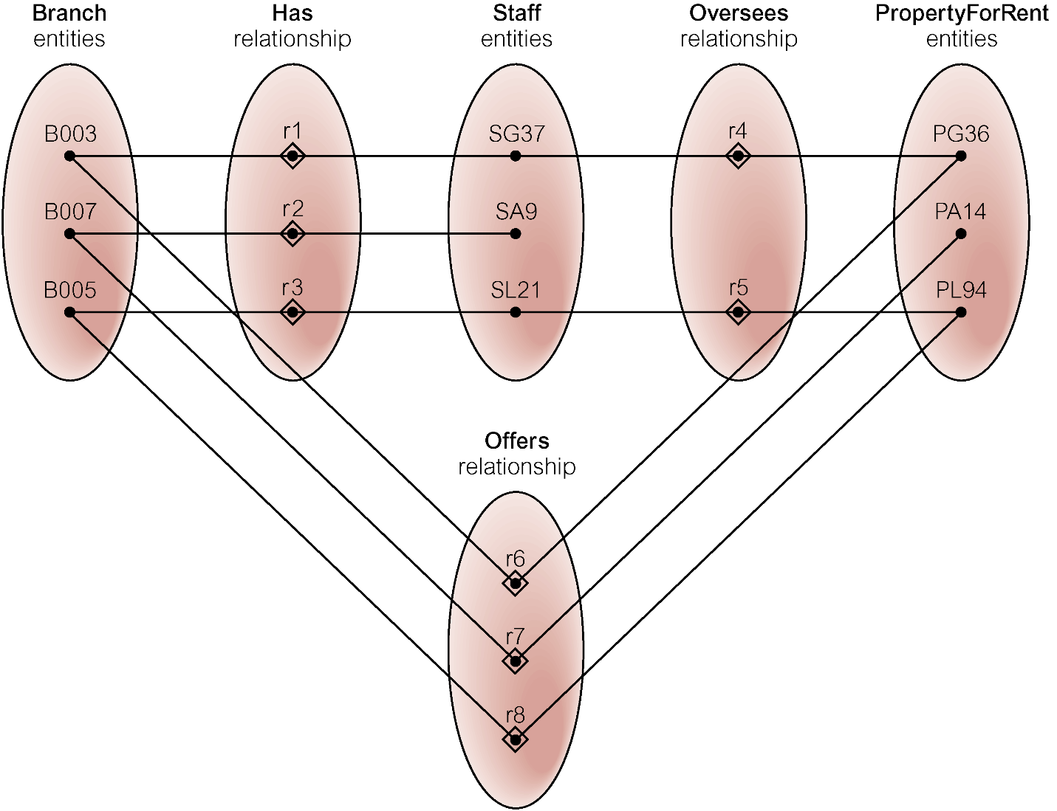
Semantic Net of Restructured ER Model with Chasm Trap Removed

